Slide 1
In the name of GOD
Menopause

Slide 2
A woman in the developed world will spend approximately a third of her life beyond menopause, so addressing the health and quality of life concerns of menopausal women is critically important.
Health and quality of life concerns of menopausal and aging women include vasomotor symptoms, symptomatic vulvovaginal atrophy, sexual dysfunction,osteoporosis, cardiovascular disease, cancer, and cognitive decline.

Slide 3
Menopause, the permanent cessation of menstruation caused by ovarian failure, occurs at an average age of 52 years, with a range of 40 to 58 years.
The age at menopause appears to be genetically determined and is unaffected by race/ethnicity or age at menarche
Factors associated with early menopause or POI include toxic exposures, genetic abnormalities, autoimmune disorders, and pelvic surgery. Women who smoke experience an earlier menopause (1), as do many women exposed to chemotherapy or pelvic radiation. Fragile X premutations, Turner mosaic karyotypes, and ovarian surgery or hysterectomy, despite retention of ovaries, may result in early menopause or PO

Slide 4
The ovarian–hypothalamic–pituitary axis remains intact during the menopausal transition; thus, FSH levels rise in response to ovarian failure and the absence of negative feedback from the ovary. Atresia of the follicular apparatus, in particular granulosa cells, leads to decreased production of estrogen and inhibin, resulting in elevated FSH levels, a cardinal sign of menopause. Antimüllerian hormone (AMH) is produced by small ovarian follicles, so levels decrease with declining ovarian reserve

Slide 5
The late reproductive stage is marked by decreased fertility and onset of menstrual cycle changes. The early menopausal transition is characterized by increased variability in menstrual cycle lengths (≥7 days), and the late menopausal transition by amenorrhea of ≥60 days. Early postmenopause
describes approximately 5 to 8 years after the final menstrual period and is followed by late postmenopause

Slide 6
Vasomotor symptoms:
Vasomotor symptoms affect up to 75% of perimenopausal women.
Symptoms last for 1 to 2 years after menopause in most women, but may
continue for up to 10 years or longer in others (5,6). Hot flashes are the primary reason women seek care at menopause. Hot flashes interrupt daily activities, disrupt sleep, and disturb women at work

Slide 7
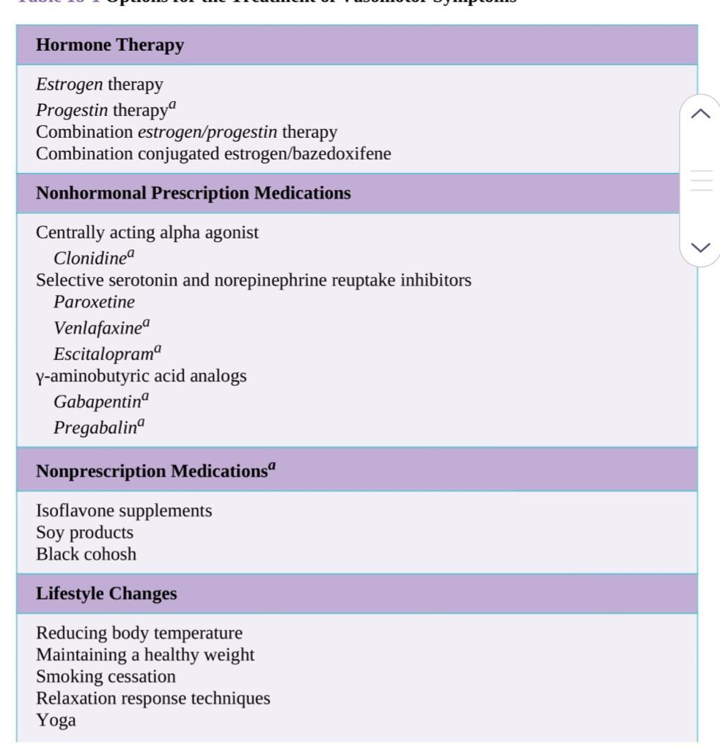

Slide 8
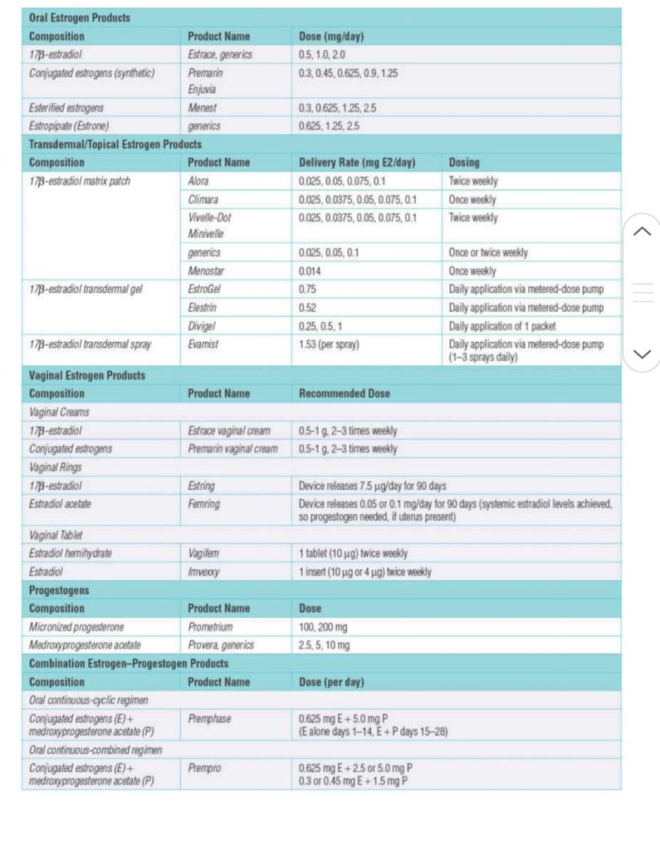

Slide 9
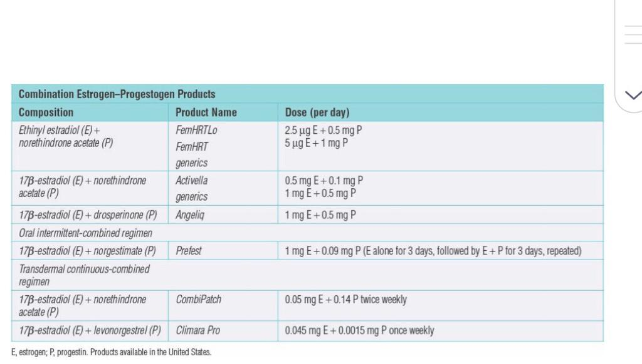

Slide 10
Genitourinary syndrom of menopause:
GSM describes anatomic changes and symptoms secondary to estrogen deficiency affecting the labia, vagina, urethra, and bladder (29). Symptoms
include bothersome genital irritation, dryness, and burning; urinary urgency, dysuria, and recurrent urinary tract infections (UTIs); and dryness
and pain with sexual activity. Vulvovaginal atrophy (VVA) is a component of GSM

Slide 11
Nonhormonal vaginal products available over-the-counter are often an initial treatment intervention. Vaginal lubricants (water, silicone, or oil based) reduce friction and increase comfort with penetrative sexual activity, including intercourse. Long-acting vaginal moisturizers used two to three times weekly line the vagina, retaining moisture and reducing symptoms (34).
Activity that stretches, stimulates, and strengthens the genital area promotes vulvovaginal health. If indicated, genital activity, with or without a partner, should be encouraged after menopause. Pelvic physical therapy (PT) and use of vaginal dilators effectively treat severe dyspareunia
If nonhormonal therapies are ineffective, ET is approved for the
treatment of vaginal dryness, dyspareunia, and related symptoms

Slide 12
Sexual dysfunction:
The etiology of female sexual dysfunction is often multifactorial, including depression or anxiety, relationship conflict, stress, fatigue, prior abuse, medications, or physical problems that make sexual activity uncomfortable, such as endometriosis or GSM. The impact of menopause per se on sexual function is uncertain
ET effectively treats vaginal dryness, dyspareunia, and vasomotor symptoms, but does not appear to have a direct effect on sexual interest, arousal, or orgasmic response, independent from its role in treating menopausal symptoms

Slide 13
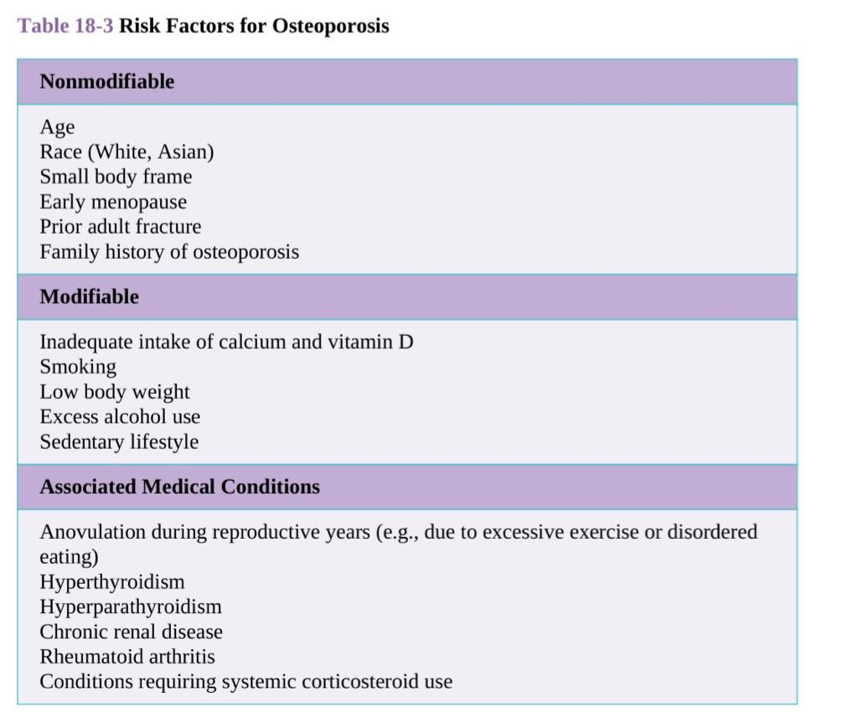
Osteoprosis:

Slide 14
Dual x-ray absorptiometry (DXA) of the hip and spine is the primary technique for BMD assessment. BMD is reported as absolute density (grams mineral/cm2) and in relation to two norms. T score is the standard deviation (SD) above or below the mean for a healthy 30-year-old
woman.
Evaluation of BMD by DXA is recommended for all women aged 65 and older, regardless of risk factors, and for younger postmenopausal women with one or more
risk factors, other than being White and menopausal

Slide 15
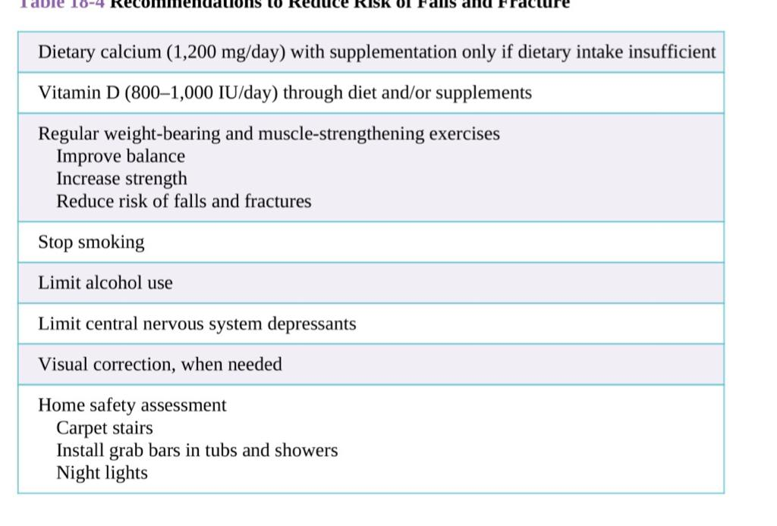
Reduce risk of fall and fractures:

Slide 16
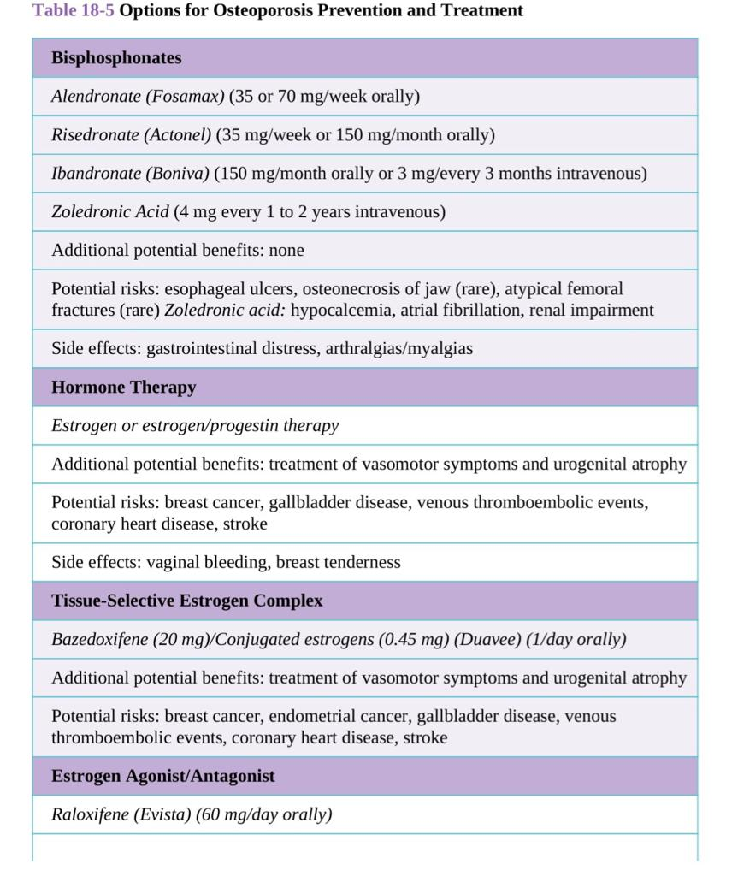

Slide 17
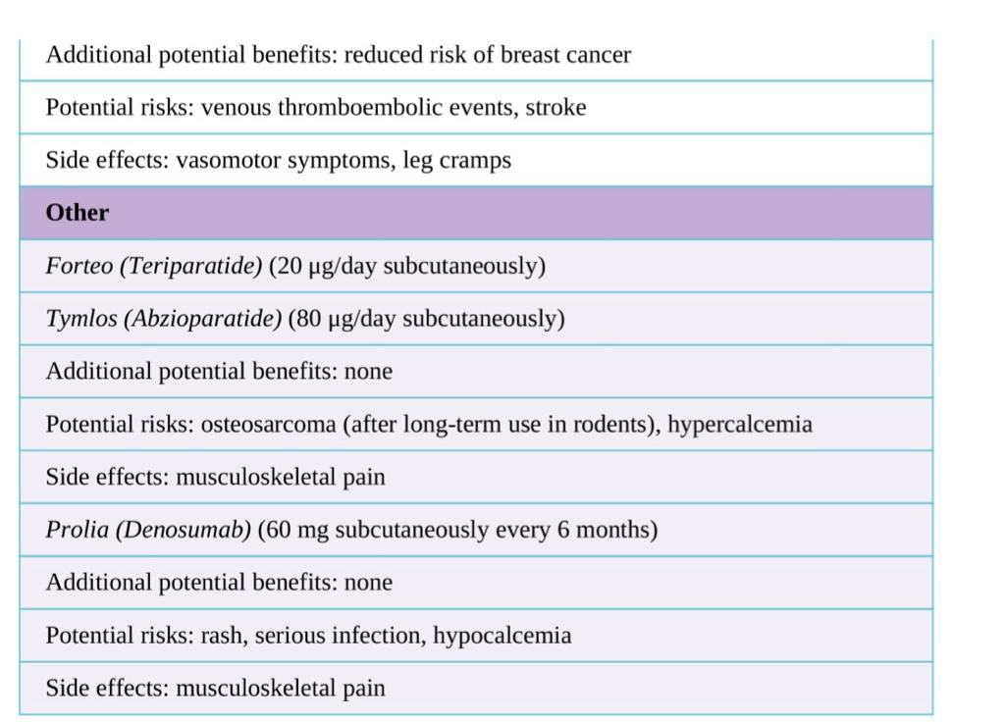

Slide 18
Cardiovascular disease:
Nonmodifiable risk factors include family history and age.
Modifiable risk factors include a sedentary lifestyle, obesity, and smoking.
Medical conditions associated with an increased risk of heart disease include diabetes, hypertension, and hyperlipidemia
These data do not support a role for HT in the prevention of heart disease, but they do provide reassurance regarding the safety of HT use for bothersome hot flashes and night sweats in otherwise healthy women under age 60 or within 10 years of menopause

Slide 19
Breast cancer:
Breast cancer is a major health concern for menopausal women, as it is the most common cancer in women and the second leading cause of cancer death
The optimal screening interval remains controversial. It is generally recommended that women at average risk be
offered initiation of screening mammography at age 40, beginning no later than age 50 years (81). Screening every 1 or 2 years is advised until at least the
age of 75 years.

Slide 20
Risk factors for breast cancer include age, family history, early menarche, late menopause, certain genetic carrier states, and prior breast disease, including epithelial atypia and cancer. Risk is reduced in women who had bilateral oophorectomy or a term pregnancy before the age of 30. Many of these risk factors are consistent with the hypothesis that prolonged estrogen exposure increases breast cancer risk.

Slide 21
The estrogen agonist/antagonist tamoxifen (20 mg per day orally) is used in the treatment of estrogen-receptor positive breast cancer. Tamoxifen and raloxifene reduce the risk of breast cancer in high-risk women by approximately 50% and are approved for this indication (85). The risk of venous thromboembolism is increased approximately threefold with the use of tamoxifen and raloxifene, similar to the increase seen with HT. Tamoxifen acts as an estrogen agonist in the endometrium, increasing the risk of endometrial polyps, hyperplasia, and cancer, whereas no endometrial stimulation is seen with
raloxifene.

Slide 22
Dementia:
Alzheimer disease is the most common form of dementia
Women should be encouraged to engage in behaviors that are associated with a lower risk of dementia, including exercising regularly, not smoking, treating underlying hypertension and diabetes, avoiding head injury, improving hearing, active learning, and staying socially engaged

Slide 23
HORMONE THERAPY USE:
The use of unopposed estrogen is associated with an increased risk of
endometrial hyperplasia and cancer. Therefore, combination EPT is
necessary for all women with a uterus. Treatment may be provided in a
sequential manner, with estrogen daily and progestin for 12 to 14 days of
each month, or in a continuous-combined fashion with estrogen and a lower dose of progestin daily.
Contraindications to HT use include known or suspected breast or
endometrial cancer, undiagnosed abnormal genital bleeding, CVD (including CHD, cerebrovascular disease, and thromboembolic disorders), and active liver or gallbladder disease. Relative contraindications include high-risk states for the above disorders

Slide 24
THANKS FOR ATTENTION

