Slide 1
THYROID DISORDERS

Slide 2
THYROID DISORDERS
are common in young women and thus frequently encountered in pregnancy.
Maternal and fetal thyroid functionare intimately related, and drugs that affect the maternal thyroid also affect the fetal gland.
thyroid autoantibodies have been associated with increased rates of early pregnancy wastage.
evidence suggests that the severity of some autoimmune thyroid disorders may be ameliorated during pregnancy, only to be exacerbated postpartum.

Slide 3
Thyroid Physiology and Pregnancy
maternal serum concentrations of thyroid binding globulin are increased concomitantly with total or bound thyroid hormone levels
thyrotropin (TSH) currently plays a central role in screening and diagnosis of many thyroid disorders.
TSH receptors are cross stimulated, albeit weakly, by massive quantities of human chorionic gonadotropin (hCG) secreted by placental trophoblast.
Because TSH does not cross the placenta, it has no direct fetal effects.

Slide 4
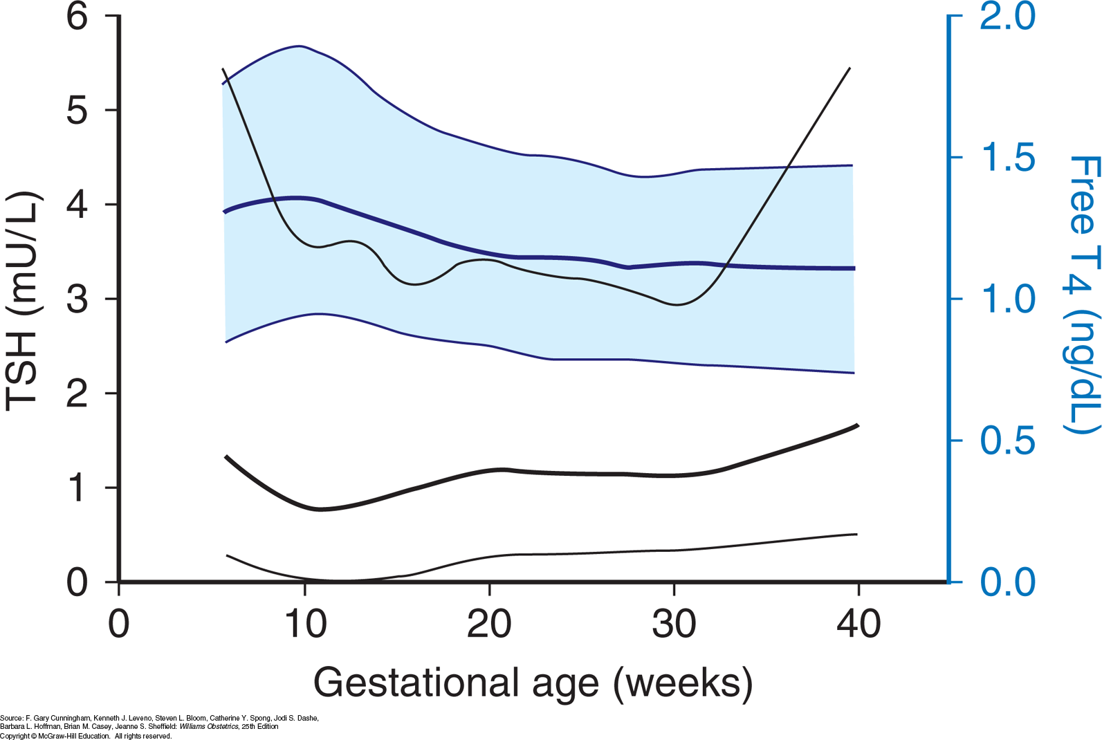

Slide 5
During the first 12 weeks of gestation, when maternal hCG serum levels are maximal, thyroid hormone secretion is stimulated.
The resulting greater serum free thyroxine (T4) levels act to suppress hypothalamic thyrotropin-releasing hormone (TRH) and in turn limit pituitary TSH secretion.
TRH is undetectable in maternal serum. Conversely, in fetal serum, beginning at midpregnancy, TRH becomes detectable, but levels are static
and do not increase.

Slide 6
Throughout pregnancy, maternal thyroxine is transferred to the fetus.
Maternal thyroxine is important for normal fetal brain development, especially before the onset of fetal thyroid gland function .And, even though the fetal gland begins iodine and synthesizing thyroid hormone after 12 weeks’ gestation, maternal thyroxine contribution remains important.
In fact, maternal sources account for 30 percent of thyroxine in fetal serum at term .

Slide 7
Autoimmunity and Thyrioid Disease
Most thyroid disorders are inextricably linked to autoantibodies
These antibodies variably stimulate thyroid function, block function, or cause thyroid inflammation that may lead to follicular cell destruction. ( overlap or coexist)
Thyroid-stimulating autoantibodies, also called thyroid-stimulating immunoglobulins (TSIs), bind to the TSH receptor and activate it, causing thyroid hyperfunction and growth.

Slide 8
Thyroid peroxidase (TPO) is a thyroid gland enzyme that normally functions in the production of thyroid
hormones.
Thyroid peroxidase antibodies, are directed against TPO and have been identified in 5 to 15 percent of all pregnant women.
These antibodies have been associated in some studies with early pregnancy loss and preterm birth .
In another study with more than 1000 TPO antibody-positive pregnant women, the risk for preterm birth was not elevated, however, the risk for placental abruption was greater .
These women are also at high risk for postpartum thyroid dysfunction and at lifelong risk for permanent thyroid failure

Slide 9
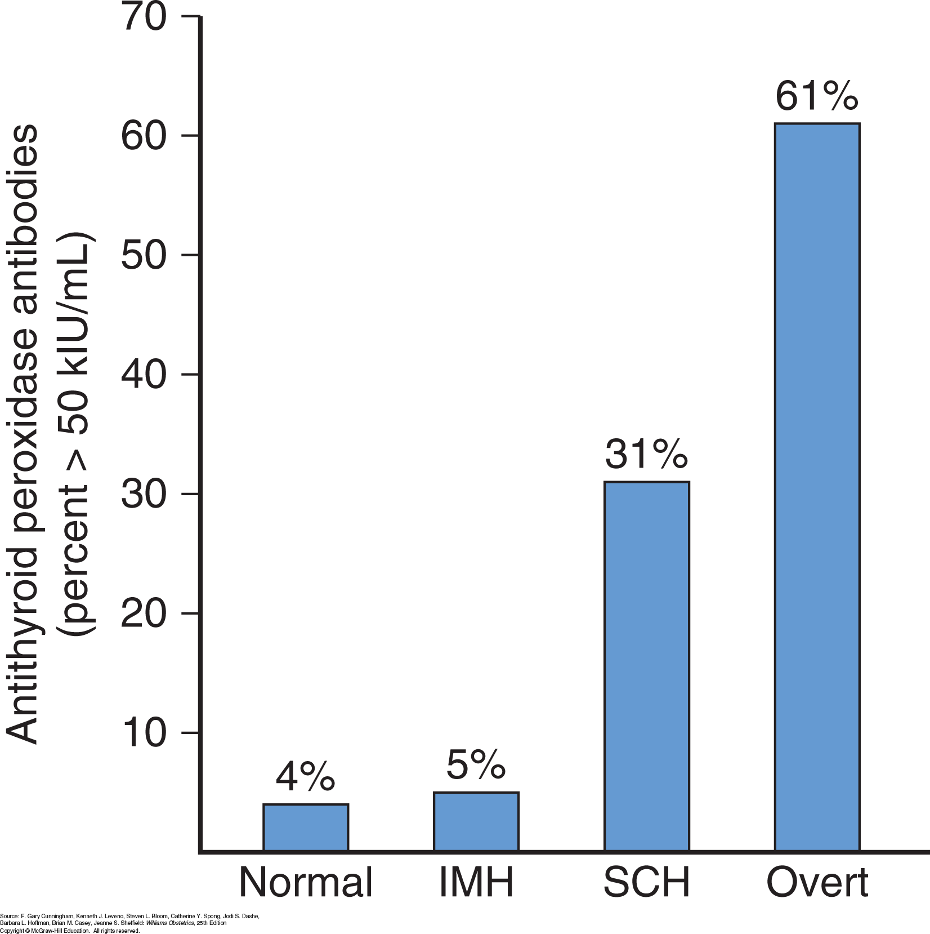

Slide 10
Fetal Microchimerism
Autoimmune thyroid disease is much more common in women than in men. One intriguing explanation for this disparity is fetal-to-maternal cell trafficking.
Fetal cells are known to enter maternal circulation during pregnancy.
Stem cell interchange can lead to engraftment in several maternal tissues and is termed fetal microchimerism.

Slide 11
Hyperthyroidism
The incidence of thyrotoxicosis or hyperthyroidism in pregnancy is varied and complicates between 2 and 17 per 1000 births when gestational-age appropriate TSH threshold values are used.
mild thyrotoxicosis may be difficult to diagnose.
Suggestive findings include tachycardia that exceeds that usually seen with normal pregnancy, thyromegaly, exophthalmos, and failure to gain weight despite adequate food intake.
Laboratory testing is confirmatory. TSH levels are markedly depressed, while serum free T4 (fT4) levels are elevated
Rarely, hyperthyroidism is caused by abnormally high serum triiodothyronine (T3) levels—so-called T3-toxicosis.

Slide 12
Thyrotoxicosis and Pregnancy
The overwhelming cause of thyrotoxicosis in pregnancy is Graves disease, an organ-specific autoimmune process associated with thyroid-stimulating TSH-receptor antibodies
At Parkland Hospital, these receptor antibody assays are generally reserved for cases in which fetal thyrotoxicosis is suspected.
during the course of pregnancy, hyperthyroid symptoms may initially worsen because of hCG stimulation but then subsequently diminish with drops in receptor antibody titers in the second half of pregnancy. (levels of blocking antibodies also decline during pregnancy.)

Slide 13
treatment
Thyrotoxicosis during pregnancy can nearly always be controlled by thionamide drugs.
(PTU) has been historically preferred because it partially inhibits the conversion of T4 to T3 and crosses the placenta less readily than methimazole.
rare methimazole embryopathy, characterized by esophageal or choanal atresia as well as aplasia cutis, a congenital skin defect
the FDA issued a safety alert on PTU-associated hepatotoxicity.
to recommend PTU therapy during the first trimester followed by methimazole beginning in the second trimester.
The obvious disadvantage: poorly controlled thyroid function.
Accordingly, at Parkland Hospital, we continue to prescribe PTU treatment throughout pregnancy.

Slide 14
Transient leukopenia :in up to 10 percent of women taking antithyroid drugs, but this does not require therapy cessation
In approximately 0.3 percent, however, agranulocytosis develops suddenly and mandates drug discontinuance It is not dose related, and because of its acute onset, serial leukocyte counts during therapy are not helpful.
Thus, if fever or sore throat develops, women are instructed to discontinue medication immediately and report for a complete blood count.
Therapy may have other side effects.
First, as noted, hepatotoxicity is a possibility and develops in approximately 0.1 percent of treated women. Serial measurement of hepatic enzyme levels does not prevent fulminant PTU-related hepatotoxicity.
Second, approximately 20 percent of patients treated with PTU develop antineutrophil cytoplasmic antibodies (ANCA). Despite this, only a small percentage of these subsequently develops serious vasculitis .
although thionamides have the potential to cause fetal complications, these are uncommon.

Slide 15
The initial thionamide dose is empirical.
For nonpregnant patients, the American Thyroid Association recommends that methimazole be used at an initial higher daily dose of 10 to 20 mg orally followed by a lower maintenance dose of 5 to 10 mg.
If PTU is selected, a dose of 50 to 150 mg orally three times daily may be initiated depending on clinical .
At Parkland Hospital, we usually initially give 300 or 450 mg of PTU daily in three divided doses for pregnant women.
Occasionally, daily doses of 600 mg or higher are necessary.
As discussed, we generally do not transition women to methimazole during the second trimester.
The goal is treatment with the lowest possible thionamide dose to maintain thyroid hormone levels slightly above or in the high normal range, while TSH levels remains suppressed.
Serum free T4 concentrations are measured every 4 to 6 weeks.

Slide 16
Subtotal thyroidectomy can be performed after thyrotoxicosis is medically controlled.
This seldom is done during pregnancy but may be appropriate for the very few women who cannot adhere to medical treatment or in whom drug therapy proves toxic .
Surgery is best accomplished in the second trimester.
Potential drawbacks of thyroidectomy include inadvertent resection of parathyroid glands and injury to the recurrent laryngeal nerve

Slide 17
Thyroid ablation with therapeutic radioactive iodine is contraindicated during pregnancy. The necessary doses may also cause fetal thyroid gland destruction.
when radioactive iodine is given unintentionally, many clinicians recommend abortion.
The International Commission on Radiological Protection has recommended that women avoid pregnancy for 6 months after radioablative therapy.
Moreover, during lactation, the breast also concentrates a substantial amount of iodine. To limit the latter, a delay of 3 months after breastfeeding cessation will more reliably ensure complete breast involution.

Slide 18
Pregnancy outcome
Women with thyrotoxicosis have pregnancy outcomes that largely depend on whether metabolic control is achieved.
For example, excess thyroxine may cause miscarriage or preterm birth .
In untreated women or in those who remain hyperthyroid despite therapy, incidences of preeclampsia, heart failure, and adverse perinatal outcomes are higher .
A prospective cohort study from China showed that women with clinical hyperthyroidism had a 12-fold greater risk of delivering an infant with hearing loss .

Slide 19
Fetal and Neonatal Effects
In most cases, the perinate is euthyroid. In some, however, hyper- or hypothyroidism can develop with or without a .Clinical hyperthyroidism.
goitrous thyrotoxicosis is caused by placental transfer of thyroid-stimulating immunoglobulins.
develops in up to 1 percent of neonates born to women with Graves disease
The best predictor of perinatal thyrotoxicosis is presence of thyroid-stimulating TSH-receptor antibodies in women with Graves disease
Thyroid Association and American Association of Clinical Endocrinologists (2011) recommend routine evaluation of TSH-receptor antibodies between 22 and 26 weeks’ gestation in women with Graves disease. The American College of Obstetricians and Gynecologists (2017), however, does not recommend such testing

Slide 20
A second presentation is goitrous hypothyroidism caused by fetal exposure to maternally administered thionamides.
Available data indicate that thionamides carry an extremely small risk for
causing neonatal hypothyroidism.
If maternal hypothyroidism developed, the fetus can be treated by a reduced maternal antithyroid medication dose and injections of intraamnionic thyroxine if necessary.

Slide 21
A third presentation, nongoitrous hypothyroidism, may develop from transplacental passage of maternal TSH-receptor blocking antibodies
Although the fetal thyroid volume can be measured sonographically in women taking thionamide drugs or in those with thyroid-stimulating antibodies, most investigators do not currently recommend this routinely
umbilical cord blood sampling and fetal antibody testing only if the mother has previously undergone radioiodine ablation.
Endocrine Society clinical practice guidelines recommend umbilical cord blood sampling only when the diagnosis of fetal thyroid disease cannot be reasonably ascertained based on clinical and sonographic data

Slide 22
Thyroid Storm and Heart Failure
Thyroid storm is a hypermetabolic state and is rare in pregnancy
pulmonary hypertension and heart failure from cardiomyopathy caused by the profound myocardial effects of thyroxine are common in pregnant women.
In these women, cardiomyopathy is characterized by a high-output state, which may lead to a dilated cardiomyopathy.
Treatment should be carried out in an intensive care area that may include special-care units within labor and
Delivery An hour or two after initial thionamide administration, iodide is given to inhibit thyroidal release of T3 and T4
Most authorities recommend dexamethasone, 2 mg intravenously every 6 hours for four doses, to further block peripheral conversion of T4 to T3.
If a β-blocker drug is given to control tachycardia, its effecton heart failure must be considered. Propranolol, labetalol, and esmolol have all been used successfully.

Slide 23
Hyperemesis Gravidarum and Gestational Transient Thyrotoxicosis
Many women with hyperemesis gravidarum have abnormally high serum thyroxine levels and low TSH levels
This results from TSH-receptor stimulation from massive—but normal for pregnancy— concentrations of hCG.
This transient condition is also termed gestational transient thyrotoxicosis.
Even if associated with hyperemesis, antithyroid drugs are not warranted.

Slide 24
Thyrotoxicosis and Gestational Trophoblastic Disease
The prevalence of increased thyroxine levels in women with a molar pregnancy ranges between 25 and 65 percent
abnormally high hCG levels lead to overstimulation of the TSH receptor
With molar evacuation, serum free T4 levels usually normalize rapidly in parallel with declining hCG concentrations

Slide 25
Subclinical Hyperthyroidism
Third-generation TSH assays with an analytical sensitivity of 0.002 mU/mL permit identification of subclinical thyroid disorders.
Treatment of subclinical hyperthyroidism is unwarranted in pregnancy because antithyroid drugs may affect the fetus. These women may benefit from periodic surveillance, and approximately half eventually have normal TSH concentrations

Slide 26
Hypothyroidism
It is characterized by insidious nonspecific clinical findings that include fatigue, constipation, cold intolerance, muscle cramps, and weight gain.
A pathologically enlarged thyroid gland depends on the etiology of hypothyroidism and is more likely in women in areas of endemic iodine deficiency or those with Hashimoto thyroiditis.
Other findings include edema, dry skin, hair loss, and prolonged relaxation phase of deep tendon reflexes.
Clinical or overt hypothyroidism is confirmed when an abnormally high serum TSH level is accompanied by an abnormally low thyroxine level.
Subclinical hypothyroidism, discussed later, is defined by an elevated serum TSH level and normal serum thyroxine concentration

Slide 27
Overt Hypothyroidism and Pregnancy
The most common cause of hypothyroidism in pregnancy is Hashimoto thyroiditis
Another cause is postablative Graves disease. Clinical identification of hypothyroidism is especially difficult during pregnancy because many of the signs or symptoms are also common to pregnancy itself
Severe hypothyroidism during pregnancy is uncommon, probably because it is often associated with infertility and higher spontaneous abortion rates
Even women with treated hypothyroidism undergoing in vitro fertilization have a significantly lower chance of achieving pregnancy

Slide 28
Treatment
for overt hypothyroidism beginning with levothyroxine in doses of 1 to 2 μg/kg/d or approximately 100 μg daily.
Women who are athyreotic after thyroidectomy or radioiodine therapy may require higher doses. Surveillance is with TSH levels measured at 4- to 6-week intervals, and the thyroxine dose is adjusted by 25- to 50-μg increments until TSH values become normal. Pregnancy is associated with an increased thyroxine requirement in approximately a third of supplemented women

Slide 29
Pregnancy Outcome with Overt Hypothyroidism
Observational studies, although limited, indicate that excessive adverse perinatal outcomes are associated with overt thyroxine deficiency Preterm birth rates, for example, are higher .With appropriate replacement therapy, however, rates of adverse effect are not increased in most reports.

Slide 30
Subclinical Hypothyroidism and Pregnancy
Earlier studies were suggestive that subclinical hypothyroidism might be associated with adverse pregnancy outcomes. In 1999, interest was heightened by two studies indicating that undiagnosed maternal thyroid hypofunction may impair fetal neuropsychological development. In one study, Pop and associates (1999) described 22 women with free T4 levels <10th percentile whose o􀁷spring were at higher risk for impaired psychomotor development. In the other study, Haddow and coworkers (1999) retrospectively evaluated children born to 48 untreated women whose serum TSH values were >98th percentile. Some had diminished school performance, reading recognition, and intelligent quotient (IQ) scores. Although described as “subclinically hypothyroid,” these women had an abnormally low mean serum free thyroxine level, and thus, many had overt hypothyroidism.

Slide 31
Screening in Pregnancy
Because of the findings in the studies from 1999 cited above, some professional organizations began to recommend routine prenatal screening and treatment for subclinical hypothyroidism. Consequent to the Lazarus study, however, clinical practice guidelines from the Endocrine Society, the American Thyroid Association,and the American Association of Clinical Endocrinologists uniformly recommended screening only those at greater risk during pregnancy (De Groot, 2012; Garber, 2012). This has been and still is the recommendation of the American College of Obstetricians and Gynecologists (2017). The findings of Casey and colleagues (2017) further buttress these recommendations.

Slide 32
Isolated Maternal Hypothyroxinemia
Women with low serum free T4 values but a normal-range TSH level are considered to have isolated maternal hypothyroxinemia. Its incidence in two large trials was 1.3 to 2.1 percent
Evolution of the knowledge of this thyroid disorder was similar to that seen with subclinical hypothyroidism. Initial studies reported that o􀁷spring of women with isolated hypothyroxinemia had neurodevelopmental different another study, Casey and colleagues (2007) found no higher risks for other adverse perinatal outcomes compared with those of euthyroid women. Also, the aforementioned CATS study did not find improved neurodevelopmental outcomes in women with isolated hypothyroxinemia who were then treated with thyroxine

Slide 33
Euthyroid Autoimmune Thyroid Disease
Autoantibodies to TPO and thyroglobulin have been identified in 6 to 20 percent of reproductive-aged women (Thangaratinam, 2011). Most who test positive for such antibodies, however, are euthyroid. That said, such women carry a two- to fivefold increased risk for early pregnancy loss
As with nonpregnant subjects with TPO antibodies, these women are also at increased risk for progression of thyroid disease and postpartum thyroiditis

Slide 34
Iodine Deficiency
Decreasing iodide fortification of table salt and bread products in the United States during the past 25 years has led to occasional iodide deficiency
Importantly, the most recent National Health and Nutrition Examination Survey indicated that, overall, the United States population remains iodine sufficient
Dietary iodine requirements are higher during pregnancy due to augmented thyroid hormone production, increased renal losses, and fetal iodine requirements. Adequate iodine is requisite for fetal neurological development beginning soon affer conception, and abnormalities are dependent on the degree of deficiency. The WHO has estimated that 38 million children are born every year at risk of lifelong brain damage associated with iodine deficiency

Slide 35
Congenital Hypothyroidism
Universal newborn screening for neonatal hypothyroidism was introduced in 1974 and is now required by law in all states. This develops in approximately 1 in 3000 newborns and is one of the most preventable causes of mental retardation. Developmental disorders of the thyroid gland such as agenesis and hypoplasia account for 80 to 90 percent of these cases. The remainder is caused by hereditary defects in thyroid hormone production
Early and aggressive thyroxine replacement is critical for newborns with congenital hypothyroidism. Still, some neonates identified by screening programs who were treated promptly will exhibit cognitive deficits into adolescence (Song, 2001). Therefore, in addition to timing of treatment, the severity of congenital hypothyroidism is an important factor in long-term cognitive outcomes. Olivieri and colleagues (2002) reported that 8 percent of 1420 newborns with congenital hypothyroidism also had other major congenital malformations

Slide 36
Postpartum Thyroiditis
Transient autoimmune thyroiditis is consistently found in approximately 5 to 10 percent of women during the first year after childbirth
Postpartum thyroid dysfunction with an onset within 12 months includes hyperthyroidism, hypothyroidism, or both. The propensity for thyroiditis antedates pregnancy and is directly related to increasing serum levels of thyroid autoantibodies. Up to 50 percent of women who are thyroid-antibody positive in the first trimester will develop postpartum thyroiditis
In clinical practice, postpartum thyroiditis is diagnosed infrequently because it typically develops months after delivery and causes vague and nonspecific symptoms. The clinical presentation varies, and classically two clinical phases that may develop in succession are recognized. The first and earliest is destruction-induced thyrotoxicosis with symptoms from excessive release of hormone from glandular disruption

Slide 37
Nodular Thyroid Disease
Evaluation of thyroid nodules during pregnancy should be similar to that for nonpregnant patients.radioiodine scanning in pregnancy is usually not recommended
Sonographic examination reliably detects nodules >5 mm, and their solid or cystic structure also is determined. According to the American Association of Clinical Endocrinologists, sonographic characteristics associated with malignancy include hypoechogenic pattern, irregular margins, and microcalcifications
Fine-needle aspiration (FNA) is an excellent assessment method, and histological tumor markers and immunostaining are reliable to evaluate for malignancy. If the FNA biopsy shows a follicular lesion, surgery may be deferred until after delivery.

Slide 38
پروتکل کشوری
میزان نرمال TSH
تریمستر اول ۰/۲-۳/۹
تریمستر دوم ۰/۵-۴/۱
تریمستر سوم ۰/۶-۴/۱
ویلیامز ۰/۲-۳/۹
۰/۵-۴/۱
۰/۶-۴/۱
در اولین ویزیت پریناتال در مواردtsh بالای ۱۰ حتما درمان شروع میشود
درصورتیکه بین ۳/۹-۱۰ باشددرتریمستر اول یا ۴/۱-۱۰ در تریمستر دوم و سوم بودابتدا و چک میشود و در صورت مثبت بودن با هر تیتری یا پایین بودن کمتر از7/5درمان شروع میشودAnti tpo t4

Slide 39
Thanks for your attention

