Slide 1
Abnormal uterine bleeding in adolescents: Evaluation and approach to diagnosis

Slide 2
NORMAL MENSTRUAL CYCLE IN ADOLESCENTS: the majority of cycles in adolescents last 21 to 45 days with two to seven days of menstrual bleeding.
Although menstrual cycles vary considerably during the first few years after menarche, the majority of cycles in adolescents last 21 to 45 days with two to seven days of menstrual bleeding.
One-half of cycles are ovulatory by one year in girls with menarche at <12 years, by three years in girls with menarche between 12 and 13 years, and by 4.5 years in girls with menarche at ≥13 year.

Slide 3
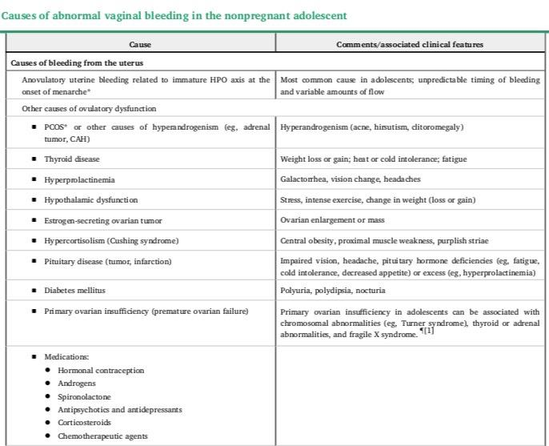

Slide 4
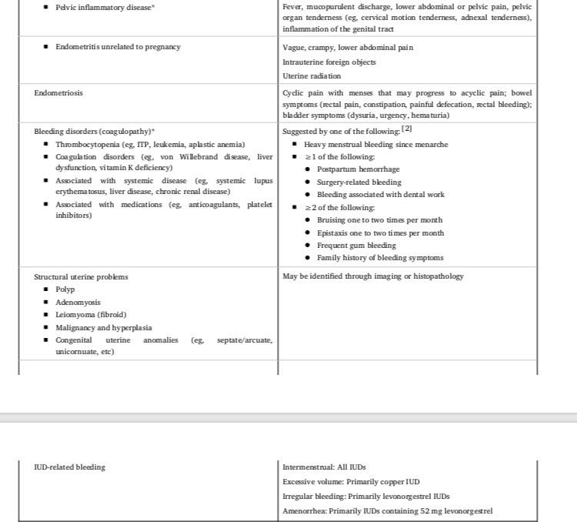

Slide 5
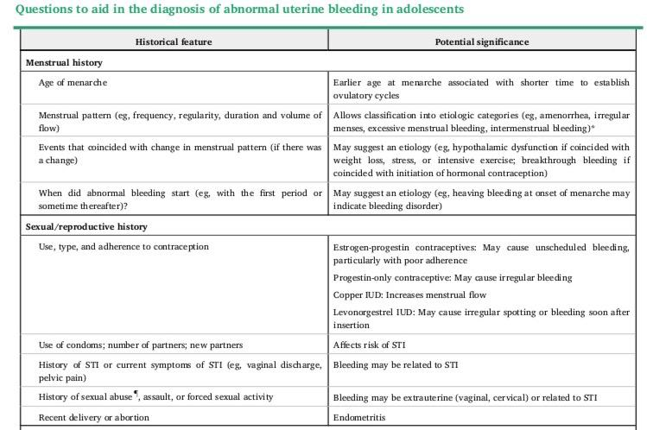

Slide 6
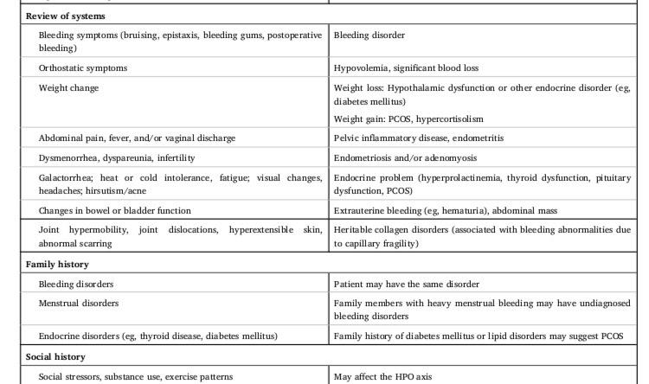

Slide 7
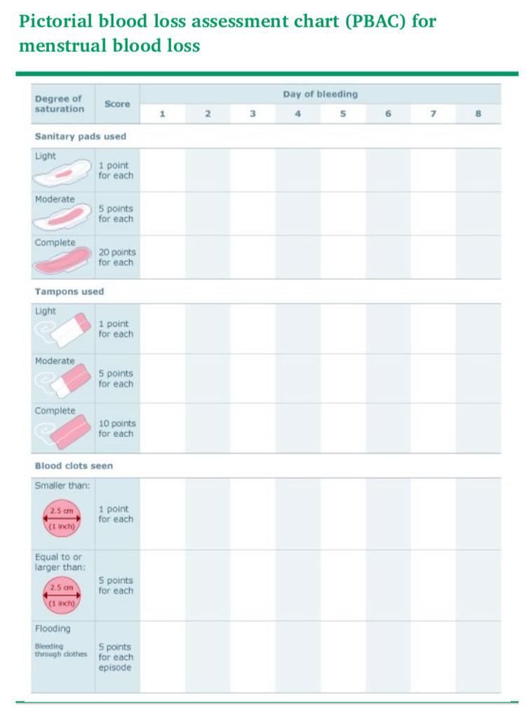

Slide 8
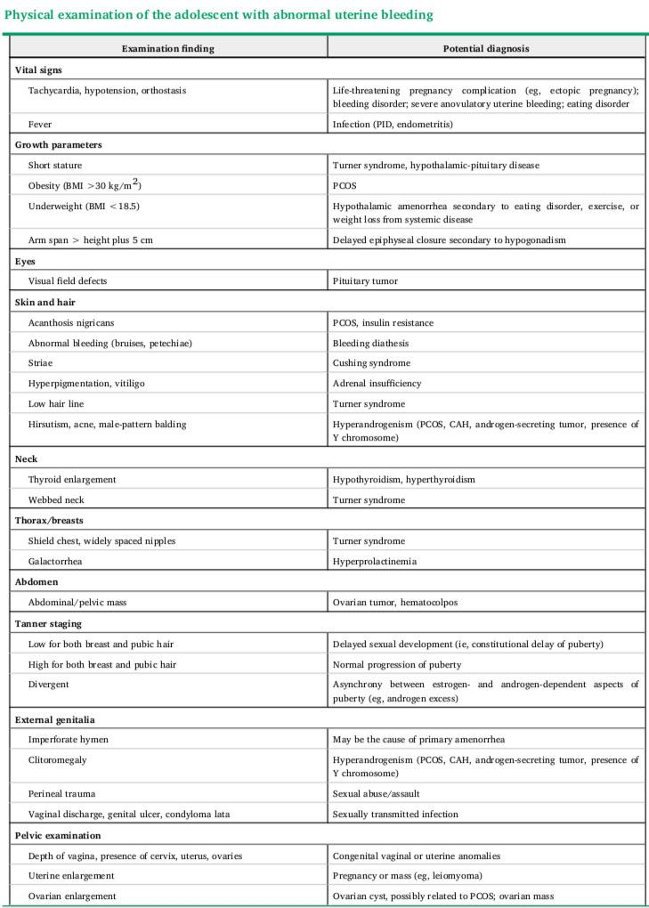

Slide 9
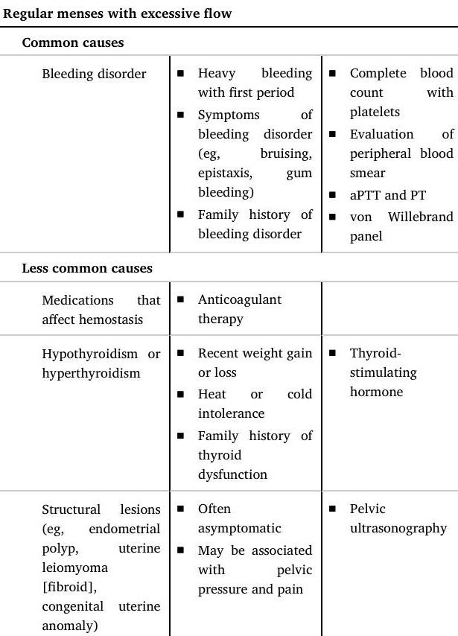

Slide 10
Excessive menstrual bleeding :
Excessive menstrual bleeding may be prolonged (>7 days) or of increased volume (>80 mL/cycle). Because neither patients nor clinicians can accurately estimate the volume of blood loss, excessive menstrual bleeding is often defined clinically (eg, soaks a pad or tampon more than every two hours
In adolescents, excessive menstrual bleeding typically occurs at irregular intervals, indicating that it is anovulatory.

Slide 11
Bleeding disorders among adolescents with excessive menstrual bleeding include, but are not limited to, von Willebrand disease, immune thrombocytopenia, platelet dysfunction, and thrombocytopenia secondary to malignancy or treatment for malignancy (ie, chemotherapy or hematopoietic stem cell transplantatio].
Among these, von Willebrand disease is most common

Slide 12
Lab:
The minimum laboratory evaluation for bleeding disorder in adolescents with excessive menstrual bleeding should include
●Complete blood count with platelets and examination of the peripheral blood smear and ferritin to detect anemia, iron deficiency without anemia, or thrombocytopenia
●Coagulation panel (activated partial thromboplastin time [aPTT]/partial thromboplastin time [PTT], prothrombin time [PT], and fibrinogen)
The evaluation generally also includes a von Willebrand panel
●Plasma von Willebrand factor (VWF) antigen
●Plasma VWF activity (ristocetin cofactor activity)
●Factor VIII activity

Slide 13
SEVERITY CLASSIFICATION
The treatment of anovulatory uterine bleeding varies with severity, which is classified as follows:
●Mild – Longer than normal menses (>7 days) or shortened cycles (<24 days) for ≥2 months, with slightly or moderately increased menstrual flow; hemoglobin is usually normal (≥12 g/dL) but may be mildly decreased (10 to 12 g/dL)
●Moderate – Moderately prolonged (eg, >7 days) or frequent menses every one to three weeks, with moderate to heavy menstrual flow and hemoglobin ≥10 g/dL .
●Severe – Disruptive menstrual cycles with heavy bleeding that causes a decrease in hemoglobin (to <10 g/dL) and may or may not cause hemodynamic instability.

Slide 14
ACUTE MANAGEMENT OF SEVERE ANOVULATORY UTERINE BLEEDING
Severe anovulatory uterine bleeding is defined by disruptive menstrual cycles with heavy bleeding that causes a decrease in hemoglobin (to <10 g/dL) with or without hemodynamic instability
Control of severe anovulatory uterine bleeding may involve:
hormonal therapy,
hemostatic agents,
and (rarely) surgical intervention.
We initiate iron supplementation as soon as the patient is stable and able to take pills by mouth. Depending upon the severity of iron deficiency, we use 60 mg of elemental iron once or twice per day.

Slide 15
Indications for hospitalization:
●Hemodynamic instability (eg, tachycardia, hypotension, orthostatic vital signs)The need for blood transfusion is assessed on a case-by-case basis, depending upon the hemoglobin, blood loss, orthostatic vital signs, and the ability to rapidly gain control of hemodynamic stability and bleeding through prompt administration of intravenous (IV) fluid, plasma expanders, and hormonal therapy
●Hemoglobin concentration <7 g/dL or <10 g/dL with active heavy bleeding.
Home management with daily monitoring may be possible for patients with hemoglobin between 8 and 10 g/dL if the patient is hemodynamically stable, able to take a regimen of hormones that can stop the bleeding, and the patient and family are reliable and can maintain close telephone contact. Home management with hormonal therapy is described below.
●Symptomatic anemia (eg, fatigue, lethargy)
●Need for intravenous conjugated estrogen (eg, cannot take oral medications, continued heavy bleeding after 24 hours of estrogen-progestin combination therapy)
●Need for surgical intervention; patients who may require surgery should be treated with intravenous therapy and maintained "nil per os" (see 'Refractory uterine bleeding' below)The patient may be discharged to home when the bleeding has stopped and she is hemodynamically stable. Close follow-up must be maintained after discharge.

Slide 16
Hormonal therapy:
Combination therapy :
Combination oral contraceptive pills are the first-line hormonal therapy for the acute management of severe anovulatory uterine bleeding.
Progestin-only therapy and IV conjugated estrogen
In adolescents who have severe anovulatory bleeding and anemia or who are at risk for anemia, the author of this topic review suggests starting with a monophasic combination oral contraceptive pill with a higher dose of estrogen (ie, 50 mcg ethinyl estradiol, which is equivalent to the dose in intravenous estrogen) and either 0.5 mg norgestrel or 1 mg norethindrone to promote control of bleeding as soon as possible; she suggests tapering according to the regimen below.
●One pill every four to six hours until the bleeding subsides (usually within 24 hours), then
●One pill every eight hours for three days, then
●One pill every 12 hours for up to two weeks, then one pill once per day.
Once the patient is weaned to one pill per day and her anemia has resolved, she should be allowed to have a withdrawal bleed (ie, by discontinuing hormones for at least three days).The adolescent must be instructed to discard the pills that do not contain hormones. Antiemetic therapy (eg, promethazine 12.5 to 25 mg orally or per rectum or ondansetron 4 to 8 mg orally) may be required for girls who are taking more than one pill per day.
Other experts may use the regimen described above with combination oral contraceptive pills with 30 or 35 mcg ethinyl estradiol and/or a different tapering schedule [3,19-23]. Regardless of the schedule, if bleeding recurs during tapering, we temporarily increase the total daily dose to the lowest dose that controls bleeding

Slide 17
Progestin-only pills :
Oral progestin-only therapy is an alternative to combination oral contraceptive pills in the acute management of girls with severe anovulatory bleeding in whom estrogen is contraindicated (eg, migraine with aura, systemic lupus erythematosus, arterial or venous thromboembolic disease, estrogen-dependent tumors, and hepatic dysfunction or disease) or who refuse to take combination oral contraceptives .Among the oral progestin-only alternatives ( we suggest norethindrone for acute bleeding. Norethindrone provides enough estrogenic activity to minimize side effects but not enough to stimulate endometrial bleeding.
Norethindrone 5 to 10 mg can be given up to four times a day based on the severity of the patient's bleeding.
Two commonly used tapering regimens are provided below:
●Norethindrone 5 to 10 mg twice per day for seven days, followed by 5 to 10 mg once per day until maintenance therapy is initiated (see 'Maintenance therapy' below)
●Norethindrone 5 to 10 mg three times per day for three days, followed by 5 to 10 mg twice per day for seven days, followed by 5 to 10 mg once per day until maintenance therapy is initiated

Slide 18
Intravenous estrogen
for patients with severe anovulatory uterine bleeding who are unstable and cannot take oral medications.
if bleeding is not controlled after 24 hours of combination hormonal therapy.
The dose of IV conjugated estrogen is 25 mg every four to six hours until the bleeding stops.
No more than six doses should be administered
After the bleeding subsides, the patient should be switched to a taper of combination monophasic oral contraceptive.
We use a monophasic oral contraceptive that contains at least 50 mcg of estradiol and suggest the following schedule:
●One pill every four to six hours until the bleeding stops
●One pill every eight hours for three days, then
●One pill every 12 hours for two weeks

Slide 19
Addition of hemostatic therapy
continues after 24 hours of hormonal therapy and in girls with platelet dysfunction .Hemostatic therapies include:
tranexamic acid,
aminocaproic acid,
desmopressin,
(which is classically used for the treatment of von Willebrand disease )
we prefer tranexamic acid unless the patient has increased risks for thromboembolism [40].
Aminocaproic acid should be avoided in patients with renal impairment
.

