Slide 1
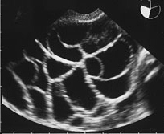
Ovarian hyper stimulation syndrome

Slide 2
Ovarian hyper stimulation syndrome is an exaggerated response to ovulation induction
The OHSS is typically associated with exogenous gonadotropin stimulation

Slide 3
OHSS is usually a self limiting disorder
Milder forms resolves spontaneously within few days , but may persist for longer periods and progress to severe disease especially if conception occurs.

Slide 4
EPIDEMIOLOGY
The frequency of OHSS depends upon the clinical setting(ovulation induction/ovarian stimulation followed by timed intercourse or IUI OR IVF)
Ovulation is induced with clomiphene or aromatase inhibitors or IUI mild OHSS
Mild :8%
Mod :3-6%
Severe :0/2-1%

Slide 5
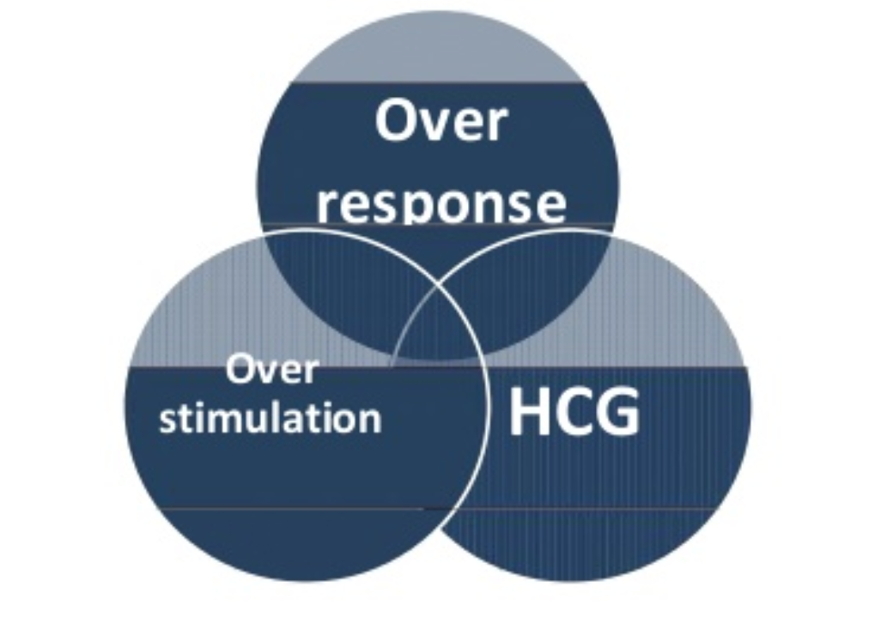
ETIOLOGY

Slide 6
PATHOGENESIS
In the spontaneous ovulatory cycle ,hypothalamic-pituitary –ovarian feedback mechanisms limit follicle recruitment to a small number of early antral follicles ,followed by selection of a single dominant follicle that ovulates in response to the midcycle luteinizing hormone(LH)surge .OHSS occurs when the equilibrium established by feedback mechanism seen in the normal menstrual cycle is by the administration of exogenous gonadotropin by HCG

Slide 7
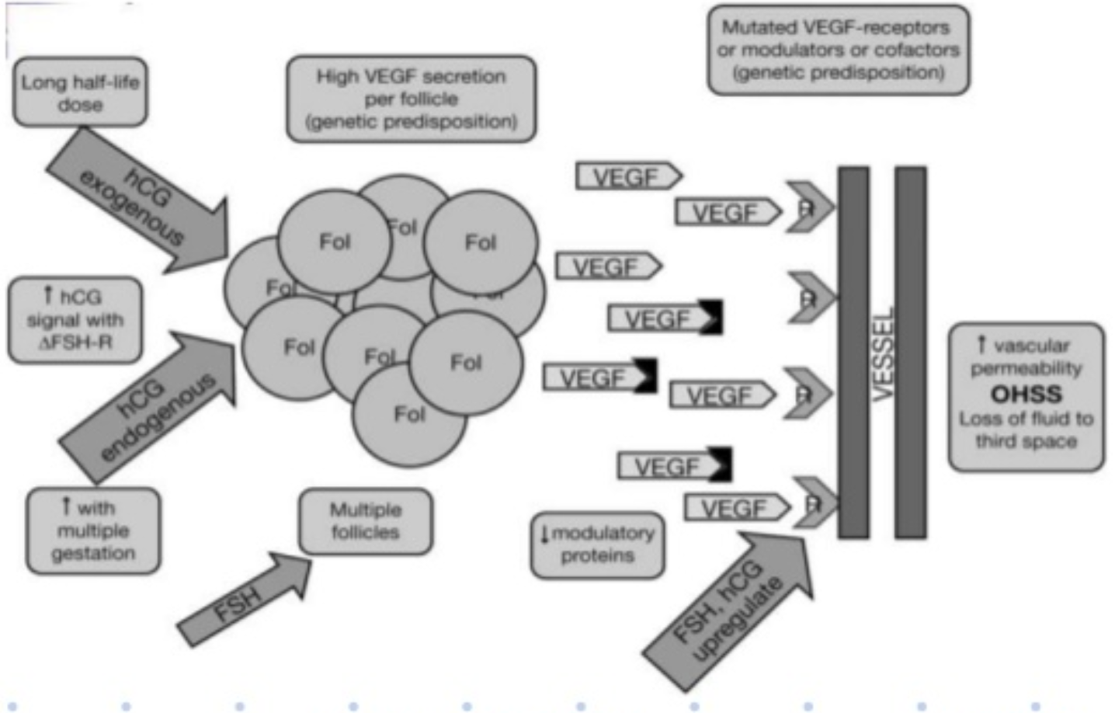
PATHOGENESIS

Slide 8
OHSS typically occurs in the setting of :
Ovarian stimulation with gonadotropins with an exuberant ovarian response ,evidenced by multiple follicular development , high serum estradiol concentrations , and ovarian enlargement by the end of stimulation.
Use of exogenous HCG to trigger the final steps of oocyte maturation
Production and release of vasoactive substances by granulosa /luteal cells
Binding of the vasoactive substances to their receptors and of downstream signalling ,leading to increased VEGF secretion from the ovary

Slide 9
Rare causes
Mutations in the FSH receptor gene
Abnormally high levels of HCG
Gonadotroph adenoma in a premenopausal woman

Slide 10
RISK FACTORS
Previous episode of OHSS
PCOS
ANTI-MULLERIAN HORMONE (AMH)>3/3
Afc >8
Pregnancy

Slide 11
Secondary risk factors :
Number of follicles (risk rises with increasing number of follicles>20 over 10mm in diameter)
High serum estradiol concentrations>3500
Number of oocytes retrieval IVF cycle
Administration of HCG rather than progesterone for luteal phase support
Pregnancy ,which increases not only the risk of late OHSS,but duration and severity of OHSS
Young pationts
Lean women

Slide 12
CLINICAL MANIFESTATIONS
ACCORDING TO THE TIME OF ONSET CLASSIFIED INTO
Early OHSS:usually mild to mod and begins 4to 7days after the ovulatory dose of HCG
Late OHSS:begins at least 9 days after the ovulatory dose of HCG

Slide 13
CLASSIFICATION
Mild
Moderate
Severe
Critical

Slide 14
MILD OHSS
Bilateral ovarian enlargement with multiple follicular and corpus luteum cysts
Abdominal distention and discomfort
Mild nausea
Vomiting
Diarrhea
There are no biochemical abnormality

Slide 15
MODERATE OHSS
Mild OHSS+ ultrasonographic evidence of ascites
Ovaries enlarged up to 12cm
Abdominal discomfort and gastrointestinal symptoms
Sudden increase in weight of more than 3 kg
Hct >41%
Wbc >15000
Hypoproteinemia

Slide 16
Severe OHSS
Ascites
Severe abdominal pain
Pleural effusion
15 to 20 kg over 5 to 10 days increase in weight
Hypovolemia
Oliguria or anuria
Intractable nausea and/or vomiting
Cr>1/6
Increase transaminases
Hct >55%
WBC>25000
Hyponatremia , hyperkalemia

Slide 17
CRITICAL OHSS
Function of vital organs and system is seriously compromised
Anuria with acute renal failure
Cardiac arrhythmia
Respiratory insufficiency
Pleural effusion becomes a massive hydrothorax
Pericardial effusion
Sepsis
ARDS
DIC

Slide 18
SPECIFIC COMPLICATIONS
Thromboembolism
Ovarian torsion

Slide 19
Diagnosis of OHSS is made by clinical history and TVS
There should be a history of ovarian stimulation followed by administration of HCG

Slide 20
Differential diagnosis :
Ectopic pregnancy
Hemorrhagic cyst
Ruptured ovarian torsion

Slide 21
MANAGEMENT
POST OHSS MANAGEMENT
PREVENTION

Slide 22
MILD OHSS:
Out patient management is the norm in mild to mod OHSS
Analgesics(acetaminophen)
Avoidance of heavy physical activity
Call for any signs or symptoms of worsening (oliguria , abdominal distention , shortness of breath , weight gain)
Antiemetics
Oral intake>1lit

Slide 23
Moderate OHSS:
Oral fluid intake of 1to2 liters per day
Ambulate ,but avoid other physical activity
Avoid sexual intercourse
Bed rest is sometimes necessary
Daily weights
Abdominal circumference measurements
Urinary output recording
Monitoring for signs of progression and every 48h thereafter:
physical exam
TVUS
Laboratory testing(CBC,electrolytes,cr,serum alb,LFT

Slide 24
Daily communication with patient:
Is hydration adequate?
Document weight ,AC , UO
Report any signs or symptoms of worsening
Pregnant patients must be followed very closely as they are likely to worsen (or present with more severe symptoms) because of the rising levels of endogenous human chorionic gonadotropin (hCG)

Slide 25
Ascites / culdocentesis :
women with tense ascites
Orthopnea
rapid increase of abdominal fluid
Aspiration of 500 mL of ascitic fluid
after aspiration of 2000 mL of ascites, a reduction in intra-abdominal pressure

Slide 26
Dopamine agonists (DA):
In women at high risk for OHSS undergoing ovarian stimulation, the rate of developing moderate OHSS can be significantly reduced with cabergoline (0.5 mg/day orally), beginning on the day of hCG administration or oocyte retrieval.

Slide 27
Prophylaxis for thromboembolic events:
All hospitalized patients with OHSS
Women with OHSS being managed as outpatients with two to three additional risk factors : age >35 years, obesity ,immobility , personal or family history of thrombosis, thrombophilias , and pregnancy
For those in whom bed rest is suggested, an intermittent pneumatic compression device is typically recommended

Slide 28
use prophylactic low molecular weight heparin, 20 mg subcutaneously every 12 hours
or heparin 5000 units subcutaneously every 12 hours

Slide 29
Severe and critical OHSS:
Hospitalization in women with severe OHSS and any of the fallowing criteria:
hematocrit >45%
leukocytes >25,000/L
creatinine >1.6 mg/dL
Women with severe abdominal pain
intractable vomiting
oliguria/anuria
tense ascites
dyspnea or tachypnea
hypotension, dizziness or syncope
severe electrolyte imbalance, or abnormal liver function

Slide 30
Critical OHSS cases should be managed in an intensive care unit (ICU)
isotonic crystalloid solutions(normal saline)
Intravenous albumin in critically ill

Slide 31
daily monitoring that are particularly important for women with OHSS include:
Assessment of fluid balance (daily or more often)
Weights and measurement of abdominal circumference
CBC
Electrolytes, blood urea nitrogen (BUN), creatinine
Serum hCG measurements (to determine if patient has conceived)
Invasive monitoring of central venous pressure
Pelvic ultrasound as needed to evaluate ovarian size and ascites
Chest radiograph and echocardiogram when pleural or pericardial effusion is suspected

Slide 32
Clinical evidence of resolution includes:
Normalization of hematocrit
Progressive reduction of ascites on ultrasound
Alleviation of clinical symptoms

Slide 33
If pregnancy occurs, resolution may take longer
OHSS pregnancies had a higher rate of miscarriage and later complications, such as gestational diabetes and pregnancy-associated hypertension

Slide 34
Prevention of OHSSS:
Recognition of risk factors for OHSS
Extensive clinical experience with drugs used for ovarian stimulation
Use of individualized ovarian stimulation regimens for assisted reproduction, using the minimum dose and duration of gonadotropin therapy necessary to achieve the treatment goal
Modifying treatment when indicators for increasing OHSS risk develop:
Serum estradiol (E2) concentration >3500 pg/Ml
Development of many intermediate-sized follicles (more than 20 follicles >10 mm)
Using an alternative to standard-dose hCG for final oocyte maturation (lower dose hCG or gonadotropin-releasing hormone

Slide 35
prevention
Insulin-sensitizing agents
Reducing dose of gonadotropins
GNRH antagonists protocols
Low dose of HCG/RHCG/RLH
alternative agents to hcg
Avoiding hcg for luteal support

Slide 36
prevention
Cycle cancellation
Coasting
Cryopreservation
Dopamine agonist

Slide 37
Insulin-sensitizing agents:
Metformin treatment before or during ART cycles decreased the risk of OHSS in pcos women

Slide 38
Reducing dose of gonadotropins:
Chronic low dose step up protocol results in better pregnancy rates with reduced incidence of OHSS compared to high dose regimens

Slide 39
GNRH antagonists protocols
The use of antagonist compared with long Gnrh agonist protocols was associated with a large reduction in OHSS and there was no evidence of adifference in live-birth rates

Slide 40
Low dose of HCG/RHCG/RLH
The trigger of oocyte maturation with low dose of hcg in high risk patients reduces the risk of OHSS
No evidence of difference between rhCG or rhLH and uhCG in achieving final follicular maturation with equivalent pregnancy rates and OHSS incidence

Slide 41
GNRH AGONIST TRIGGER
Use of gnrh agonist instead of HCG for trigger results in a lower incidence of OHSS but extremely high early pregnancy loss due to luteolysis
Women at high risk for OHSS (development of multiple follicles during ovarian stimulation [>20 follicles ,over 10 mm
Women undergoing ovarian stimulation who plan to donate oocytes to recipients
women planning to freeze their oocytes or embryos for future use

Slide 42
Avoiding HCG FOR LUTEAL PHASE SUPPORT
Progesterone ,hcg,or gnrh agonists are used for lps but use of hcg was linked to significantly higher risk of OHSS
Progesterone seems to be the best option as lps in high risk patients with out the risk of OHSS

Slide 43
CANCELLATION
CYCLE cancellation before administration of hcg is an effective strategy for the prevention of OHSS

Slide 44
COASTING
Coasting involves withholding further gonadotropin stimulation &delaying hcg administration until E2levels plateau or decrease significantly

Slide 45
CRYOPRESERVATION
CRYOPRESERVATION involves freezing of all embryos to be thawed &implanted at a later date

Slide 46
DOPAMIN AGONIST
We suggest dopamine agonist administration in women at high risk for OHSS
Dopamine agonists inhibit VEGF receptor phosphorylation and thereby decrease vascular permeability
Cabergoline (0.5 mg daily beginning on the day of hCG administration)
Quinagolide – , another dopamine agonist, appears to reduce the risk of early onset severe OHSS.(50, 100, or 200 mcg/day beginning on the day)

Slide 47
RECOMMENDED
Metformin co-treatment in pcos
Gnrh antagonist protocol
Gnrh agonist trigger
Avoiding hcg for luteal support
Dopamin agonists

Slide 48
Thank you

