Slide 1
Leiomyomata Uteri and Myomectomy

Slide 2
ETIOLOGY, PATHOLOGY, AND GROWTH CHARACTERISTICS OF UTERINE LEIOMYOMATA
A leiomyoma is a benign tumor composed mainly of smooth muscle cells but containing varying amounts of fibrous connective tissue
The tumor is well circumscribed but not encapsulated
Leiomyomata are the most common tumors of the uterus and female pelvis
Leiomyomata are responsible for about one third of all hospital admissions to gynecology services
It is well recognized that the incidence is much higher in African American than in Caucasian women.

Slide 3
ETIOLOGY, PATHOLOGY, AND GROWTH CHARACTERISTICS OF UTERINE LEIOMYOMATA
Patients with uterine leiomyomata often have a positive family history of uterine leiomyomata.
About 40% to 50% of leiomyomas show karyotypically detectable chromosomal abnormalities: Identified chromosomal abnormalities include t(12;14) (q15;q23-24), del(7) (q22q32), rearrangements involving 6p21, 10q, trisomy 12, and deletions of 3q.

Slide 4
The growth of leiomyomata is dependent on estrogen production.
After menopause, with regression of ovarian estrogen secretion, growth of leiomyomata usually ceases.
However, of postmenopausal growth of benign leiomyomata, suggesting the possibility of postmenopausal estrogen production either in the ovary or elsewhere.

Slide 5
Postmenopausal ovarian cortical stromal hyperplasia may be associated with an increase in estrogen secretion by the ovary.
The postmenopausal ovarian stroma in a variety of presumably inactive ovarian tumors, including mucinous cysts and Brenner tumors, can also produce estrogen.
When a central pelvic tumor presumed to beuterine leiomyomata enlarges after menopause, one should think of the possibility of malignant change in the leiomyoma itself or in the adjacent myometrium, or of the growth of a new pelvic tumor of extrauterine origin.

Slide 6
Older nulliparous women have an increased risk of developing leiomyomata. However, in multiparous women, the relative risk decreases with each pregnancy.
The risk is reduced in women who smoke and is increased in obese women; this is possibly related to the conversion of androgens to estrogen by fat aromatase.

Slide 7
The observation that leiomyomata may show significant enlargement during pregnancy provides further clinical evidence of the relation of estrogen and progesterone to the growth of these tumors.
However, a better blood supply during pregnancy might also encourage their growth.

Slide 8
Oral contraceptives containing high-dose estrogen, there was a striking increase in the occurrence of large leiomyomata
Oral contraceptives containing highdose estrogen should not be prescribed for women with these tumors.
Oral contraceptives with low-dose estrogen are less likely to stimulate growth.

Slide 9
Levels of plasma estradiol were the same in patients with and without leiomyomata.
Significantly higher concentration of estrogen receptors in leiomyomata than in myometrium.
The enzyme 17β-hydroxy dehydrogenase accelerates the conversion of estradiol to estrone.
Leiomyomata low concentration of 17β-hydroxy dehydrogenase Myometrial Hypertrophy

Slide 10
Abnormal pituitary function in women with leiomyomata:
low FSH level and a diminished FSH response to pituitary GnRH.
There was an excessive prolactin response to TRH.
Peak levels of human growth hormone during a hypoglycemic test
Significant increase in 5α-reductase

Slide 11
Both estrogen and progesterone are involved in the growth of uterine leiomyomata.
Polypeptide growth factors that have been investigated include epidermal growth factor, transforming growth factor alpha and beta, insulin-like growth factor (IGF), platelet-derived growth factor, vascular endothelial growth factor, and basic fibroblast growth factor.

Slide 12
Leiomyomata may be single, but most are multiple.
They develop most commonly in the uterine corpus and much less often in the cervix.
They may develop in the round ligaments, but this is rare.
Because they arise in the myometrium, they are all interstitial or intramural in the beginning.
Subserous or Submucous

Slide 13
A subserous tumor can become pedunculated and occasionally parasitic, receiving its blood supply from another source, usually the omentum.
A submucous tumor can also become pedunculated and may gradually dilate the endocervical canal and protrude through the cervical os. Indeed, a submucous myoma may descend through the vagina.
Rarely, chronic uterine inversion results if the prolapsing submucous leiomyoma is attached to the top of the endometrial cavity and pulls the uterine fundus downward through the cervix.

Slide 14
Subserous and subserous pedunculated tumors, as well as intraligamentous tumors, may create problems in diagnosis because they are difficult to distinguish from tumors arising from the adnexal organs
Ordinarily, there is a clear distinction between the myoma and the myometrium so that dissection between the two is easy to accomplish
Although these tumors are not encapsulated, a clear distinction can usually be made between a myoma and the myometrium that surrounds it.
The cut surface appears as glistening pinkish white and gray

Slide 15
Hyaline Degeneration
The most common change
The cut surface of a hyalinized area is smooth and homogeneous
These may become liquefied and form cystic cavities filled with clear liquid or gelatinous material

Slide 16
calcified leiomyomata
Over time, with continued diminished blood supply and ischemic necrosis of tissue, calcium phosphates and carbonates are deposited in myomata.
When the degenerative change is advanced, the leiomyoma may become solidly calcified. Such calcified tumors have been called “womb stones.”
Most often in elderly women, in African American women, and in women who have pedunculated subserous tumors.
They are easily seen radiographically

Slide 17
infection
Submucous leiomyomata are most commonly infected when they protrude into the uterine cavity, or especially into the vagina
An intramural leiomyoma in an involuting puerperal uterus can also become infected when endometritis is present.
Such infections are usually Streptococcal and may be virulent. Bacteroides fragilis infections also occur.
Parametritis, peritonitis, and even septicemia may result.

Slide 18
Necrosis of a leiomyoma is caused by interference with its blood supply. Occasionally, a pedunculated subserous leiomyoma twists, and if an operation is not done immediately, infarction results.

Slide 19
red or carneous degeneration
Necrotic leiomyomata are dark and hemorrhagic in the interior.
Eventually, the tissue breaks down completely. So-called red or carneous degeneration is seen occasionally, especially in association with pregnancy.
This condition is thought to result from poor circulation of blood through a rapidly growing tumor. Thrombosis and extravasation of blood into the myoma tissue are responsible for the reddish discoloration

Slide 20
fatty degeneration
Fat occurs in leiomyomata as true fatty degeneration
The cut surface may have a yellowish discoloration.
Infrequently, a deposit of true fat may form a fibrolipoma; however, the presence of fat in a leiomyoma is rare.
If fat is seen grossly or microscopically in a curettage specimen, one should not assume that it represents fatty degeneration of a leiomyoma. One should assume that the uterus has been perforated and that fragments of fat have been curetted from the mesentery or omentum.

Slide 21
sarcomatous degeneration
The most important, but rare, change in a leiomyoma
A sarcoma is likely to occur in a rather large leiomyoma and toward the center of the tumor, where the blood supply is poorest.
The tissue is soft and homogeneous and is described as resembling raw pork. Later, as necrosis of the malignant tissue occurs, it becomes more friable and hemorrhagic.

Slide 22
All tumors with less than 5 mitotic figures per 10 high-power fields are considered benign.
All tumors with more than 10 mitotic figures per 10 high-power fields are called malignant.
Those in between can be called smooth muscle tumors of uncertain malignant potential.
Presence of nuclear hyperchromatism, nuclear pleomorphism, or giant cells and other bizarre cell forms to makethe diagnosis.
Smooth muscle tumors that metastasize or recur are definitely malignant

Slide 23
A normal chromosome complement (46,XX)
About 50% showed clonal abnormalities, such as those of chromosomes 1, 7, and 13, and t(12;14).

Slide 24
intravenous leiomyomatosis
The characteristic feature of this peculiar smooth muscle tumor is the extension of the polypoid intravascular projections into the veins of the parametrium and broad ligaments.
The uterine veins in the broad ligaments are the most common sites of extension
clinically like a benign neoplasm
Total surgical excision of the tumor should be attempted for successful therapy
Extension of benign leiomyomatosis up the vena cava and into the right atrium has been reported

Slide 25
Several recent cases requiring open heart surgery to remove the intracardiac tumor thrombosis have been successful and without recurrence
Both intravenous leiomyomatosis and benign metastasizing leiomyoma have been reported to metastasize to the lung
Oophorectomy may be indicated in patients with these conditions

Slide 26
Leiomyomatosis peritonealis disseminata
Only subperitoneal surfaces of the uterus and other pelvic and abdominal viscera are involved
Invasion of the lumen of blood vessels does not occur.
All occurred in patients in the reproductive years who often had large uterine leiomyomata and were usually pregnant or taking oral contraceptives
The tumor is benign, and the acceptable treatment to date is total abdominal hysterectomy and bilateral salpingo-oophorectomy
If this tumor occurs in the omentum, an omentectomy should also be performed to define more clearly the histologic nature of the lesion.

Slide 27
vascularization of leiomyomata
Leiomyomata have a rich vascular supply, including blood lakes within tumors.
Venous channels were predominantly peripheral, whereas the arterial supply was both internal and peripheral.

Slide 28
CLINICAL FEATURES OF UTERINE LEIOMYOMATA
Most leiomyomata are asymptomatic
Small leiomyomata that are asymptomatic need only to be observed from time to time, with pelvic examinations perhaps every 6 to 12 months and pelvic ultrasonography (US) when indicated.
If small leiomyomata are discovered late in menstrual life, it is unusual for symptoms to appear or for surgical treatment to be required.

Slide 29
surgical removal of leiomyomata when the uterus reaches 12 weeks gestational size or greater, regardless of the presence or absence of significant symptoms.
The inability to accurately assess the ovaries by examination
The possible malignancy of the pelvic mass
The potential for compromise of adjacent organ function if the mass continues to enlarge
The greater risk of surgical complications if the mass grows to a larger size
The potential for better fertility if myomectomy is performed when the uterus is smaller
The possibility of continued growth of uterine leiomyomata if hormone replacement therapy is given after menopause

Slide 30
If one elects to observe a patient with a relatively large asymptomatic uterine leiomyoma, it is a good rule to obtain an excretory urogram or renal ultrasound.
Ureteral compression at the pelvic brim may occur so that hydroureter and hydronephrosis develop

Slide 31
In the postmenopausal years, shrinkage of myomata and the myometrium occurs. However, the myometrial shrinkage may be disproportionately greater than the myoma shrinkage. Therefore, a myoma in an intramural location before menopause may become a submucous myoma after menopause and then become symptomatic for the first time, usually with postmenopausal bleeding.
In menopausal women, the appearance of even the slightest trace of vaginal bleeding should make one suspect
cervical or endometrial malignancy or the possibility of sarcomatous change in the leiomyoma

Slide 32
detection of leiomyomas
Transabdominal and endovaginal US
Sonohysterography
CA-125 levels may be elevated in women with uterine leiomyomata, but the levels are generally lower than those in patients with ovarian cancer.

Slide 33
Symptomatic Leiomyomata
Abnormal Bleeding
Pressure
Pain
Abdominal Distortion
Rapid Growth:a gain of 6 weeks or more in gestational size within a year or less
Spontaneous Abortion and Other Pregnancy-Related Problems
Infertility
Miscellaneous Signs and Symptoms

Slide 34
CHOICE OF TREATMENT FOR UTERINE LEIOMYOMATA
Medical Management of Uterine Leiomyomata
Effective medical treatment that is likely to result in the permanent cure of uterine leiomyomata is not yet available.
Medical therapies are available as an adjunct to surgical treatment or as a temporary substitute for definitive surgical treatment.

Slide 35
Antiprogestin therapy with mifepristone (RU-486)
25 mg daily
decrease leiomyoma volume by an average of 49% for 3 months
All patients became amenorrheic
Side effects were mild, and bone density was not diminished
Gestrinone
antiestrogen and antiprogesterone properties
The treatment lasted 6 months to 1 year.
The best results were obtained when the drug was administered intravaginally
Side effects, though mildly androgenic, were well tolerated

Slide 36
GnRH analogs
“medical oophorectomy” and “medical menopause”
describe a significant reduction in trabecular bone density after 24 weeks of GnRH agonist treatment
the average reduction in uterine and myoma volume is 40% to 50% after 3 to 6 months of GnRH agonist treatment
If there are circumstances that require that GnRH treatment be extended beyond 6 months, consideration should be given to adding low-dose steroids after 3 months of GnRH therapy

Slide 37
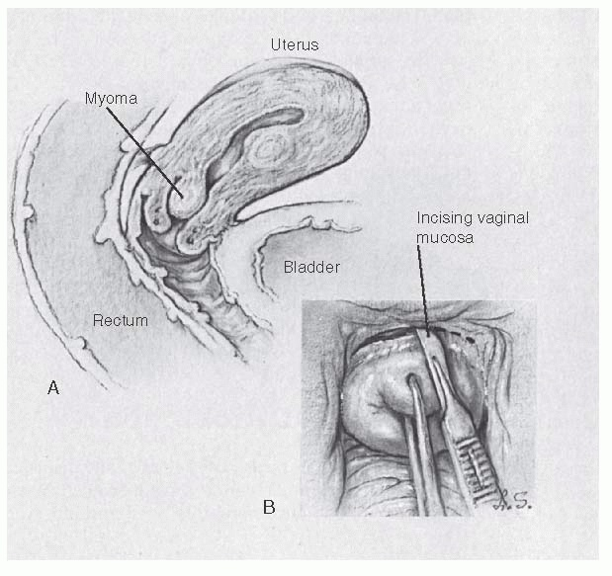
Vaginal Myomectomy

Slide 39
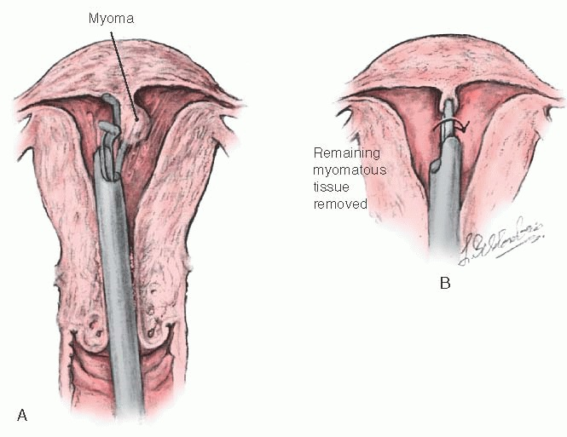
Hysteroscopic Resection of Submucous Myomata
Laparoscopic and Robotic-Assisted Myomectomy
Abdominal Myomectomy

Slide 40
Position the patient in Allen stirrups.
Perform exam under anesthesia, paying careful attention to uterine size and mobility.
Prep and drape the patient.
Place Foley.
Perform cervical dilation, and consider staining the endometrial cavity.
Make an abdominal incision (consider Maylard for uteri >12-week size), and enter the abdominal cavity.
Optimize exposure (incision type and size, lighting, packing of intestines, retractors).
Evaluate number, size, and location of fibroids.

Slide 41
Minimize blood loss.
Make use of delicate surgical technique (avoid traumatic instruments).
Consider hypotensive anesthesia.
Consider use of a tourniquet.
Consider use of dilute Pitressin.
Make a linear uterine incision over the largest myoma.
Dissect along the natural tissue plane, and excise the myoma.
Meticulously close all uterine defects.
Confirm hemostasis.
Close abdominal cavity, fascial, and skin incisions.

Slide 42
decrease surgical bleeding
Controlled hypotensive anesthesia
Trendelenburgposition
Tourniquets
Vasoconstrictive agents
The CO2 laser

Slide 44
Results of Myomectomy
The major immediate postoperative complications after myomectomy are febrile morbidity and intraperitoneal bleeding.
patients must be carefully monitored for the first 24 hours after myomectomy
A hematocrit is usually performed 6 hours after the operation is completed and again on the first postoperative morning

Slide 45
Embolotherapy
UAE is appropriate for patients with symptomatic leiomyomata
Contraindications to this procedure include pregnancy, active pelvic infection, severe contrast medium allergy, arteriovenous malformations, desire for future pregnancy, a strong suspicion of adenomyosis or pedunculated leiomyoma, and undiagnosed pelvic mass.
may increase the risk of miscarriage, postpartum hemorrhage, preterm delivery, and malpresentation

Slide 46
postembolization syndrome
Forty percent of patients develop a syndrome of fever and malaise in the first 10 to 14 days after UAE.
This is also associated with leukocytosis.
It is typically selflimited and resolves in 3 to 5 days and rarely requires treatment except antipyretics.

Slide 47
THANK YOU

Slide 48
خانم 45 ساله مولتی پار آنمیک با شکایت منوراژی از 2 سال قبل و عدم پاسخ به درمان دارویی مراجعه کرده است. خون ریزی وی از سه ماه قبل تشدید شده و در سونوگرافی واژینال میوم های متعدد با اثر فشاری بر اندومتر دارد. اقدام مناسب کدام است؟
بیوپسی اندومتر
ابلیشن اندومتر
میومکتومی
هیسترکتومی

Slide 49
پاسخ: الف
صرفاً وجود لیومیوم در یک خانم، خون ریزی رخمی غیرطبیعی را ثابت نمی کند که میوم باعث خون ریزی است و ارزیابی و نمونه برداری باید صورت گیرند.

Slide 50
در مورد UAE کدامیک از گزینه های زیر صحیح است؟
در فیبروم های بزرگ علامتدار و نازایی انتخاب اول می باشد.
در درمان آدنومیوزیس کمک کننده است.
در درمان مالفورماسیون های شریانی و وریدی توصیه می شود.
در تب و لکوسیتوز و بی حالی متعاقب آن ضد تب توصیه می شود.

Slide 51
پاسخ: د

Slide 52
در خانمی که به علت فیبروم رحمی تحت درمان با میفه پروستون به مدت 6 ماه قرار گرفته است کدام عارضه ممکن است مشاهده شود؟
کاهش دانسیته استخوانی
خشکی واژن
هیپرپلازی اندومتر
کاهش لیبیدو

Slide 53
پاسخ: ج

Slide 54
در خانم 47 ساله مبتلا به منوراژی شدید به علت فیبروم رحمی با کدام یک از روش های درمانی زیر خطر هیپرپلازی اندومتر وجود دارد؟
OCP
میفه پروستون
آگونیست GnRH
ناپروکسن

Slide 55
پاسخ: ب

