Slide 1
Increased NT with normal karyotype
E.Keshavarz MD
Shahid beheshty university
Mahdieh hospital

Slide 2
Pathophysiology of increased NT
1-Cardiac failure
2-Venous congestion in head and neck
3-Abnormal or delay development of lymphatic system
4-Failure of lymphatic drainage
5-Fetal anemia/ hypoproteinemia
6-Congenital infection
7-Altered composition of the extracellular matrix

Slide 3
1-cardiac failure
1-narrowing of aortic isthmus…dilated ascending aorta…over perfusion of head and neck (21,18,13)
21:AVSD/VSD
18:Valvular/VSD
13:Valvular/AVSD/VSD/thruncus arteriosus
Turner : coarectation and spectrum of left heart obstruction(compression of descending aorta by the distended intra thoracic lymphatic channels)

Slide 4
2-venous congestion in head and neck
1-amnion rupture…constriction of fetal body
2-diaphragmatic hernia…sup mediastinal compression
3-skeletal dysplasia…narrow chest

Slide 5
3-abnormal or delay development of lymphatic system
Turner
thyrosine kinase gene (x)
V.E.GF
lymphatic chain development
Overdistention of lymphatic sac due to failure of communication with the internal jugular vein

Slide 6
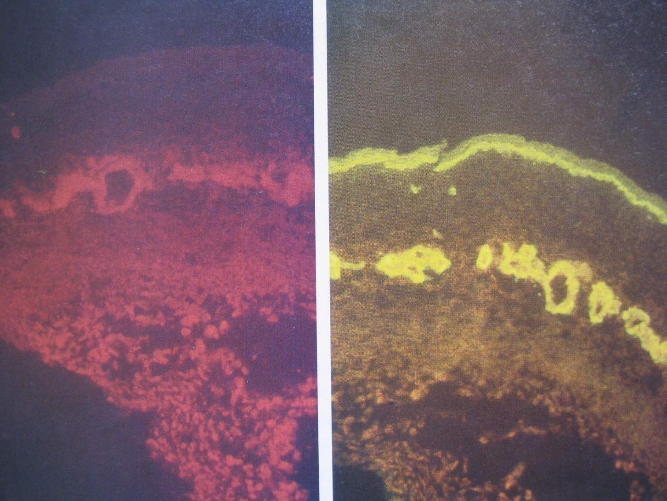
Left:Single staining with monoclonal PTN63 Ab-absence of lymphatic channels in upper dermis-dilated channel in sudcutis
Right:Double staining both PTN63+laminin Ab

Slide 7
4-failure of lymphatic drainage
Neuromuscular disorder
…impaired fetal movement
…failure of lymphatic drainage

Slide 8
5-fetal anemia/ hypoproteinemia
1-immune and nonimmune hydropse
anemia and hypoproteinemia (anemia…high C.O.H.F)
2- homozygous alfa-thalasemia
overal increase in NT:0.4 mm compared with normal controls ???
The source of maternal serum AFP (reduced in Down) is fetus

Slide 9
6-congenital infection
1-TORCH
myocardial infection…cardiac dysfunction
B.M suprresion …anemia…high C.O.H.F
2-PB19
B.M suprresion …anemia…high C.O.H.F

Slide 10
7-altered composition of the extracellular matrix
21,18,13
many of component protein of extracellular matrix are encoded on ch 21,18,13
21:increased collagen 6…binding to H.A…interstitial edema (skin,…)
decreased degradation of H.A…hyaloronan-aggregating proteoglycans in bowel segment…inhibit the migration of neural crest cells…Hirschprung
18:increased laminin
13:increased collagen 4

Slide 11
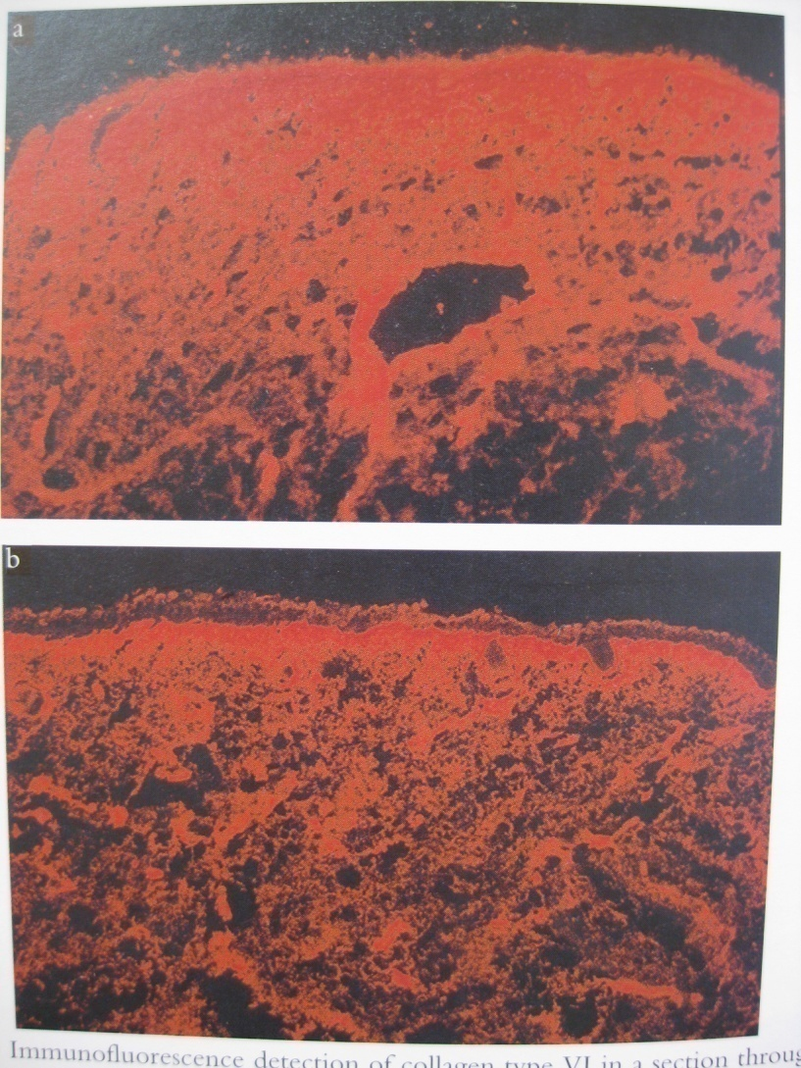
Immunofluorescense detection of collagen 6 in a section through nuchal skin of trisomy 21(above) and in a normal fetus

Slide 12
Conditions associated | with increased NT
Cardiac defects | Jarcho-Levin syndrome
Diaphragmatic hernia | Joubert syndrome
exomphalos | Meckel_Gruber syndrome
Achondrogenesis type 2 | Nance-Sweeney syndrome
achondroplasia | Noonan syndrome
Asphyxian thoracic dystrophy | Osteogenesis imperfecta type 2
Beckwith-Wiedemann syndrome | Perlman syndrome
Blomstrand osteochondrodysplasia | Robert syndrome
Body stalk anomaly | Short-rib polydactyly syndrome
Campomelic dysplasia | Smith-Lemli-Opitz syndrome
EEC syndrome(ectrodactily ectodermal cleft palate) | Spinal muscular atrophy type 1
Fetal akinesia deformation sequence | Thanatophoric dysplasia
Fryn syndrome | Trigonocephaly ‘C’ syndrome
GM1-gangliosidosis | VACTERL syndrome
Hydrolethal syndrome | Zellweger syndrome

Slide 13
1-Blomstrand osteochondrodysplasia:short long bones+hemosidrosis+increased bone density
2-Fryn syndrome:DH+digital defects+coarsed face+short webbed neck
3-Hydrolethal syndrom : separate hemisphere+ C.C agenesis+ hydrocephaly+ drainage of lateral ventricles to the midline fluid filled space +cardiac defect+ polydactyly + facial cleft
4-Nance-Sweeney syndrom:Bone+deafness+face

Slide 14
Different studies results
Between 510 chromosomally normal fetuses with increased NT(summation of many different studies):
77 (15%) have defects

Slide 15
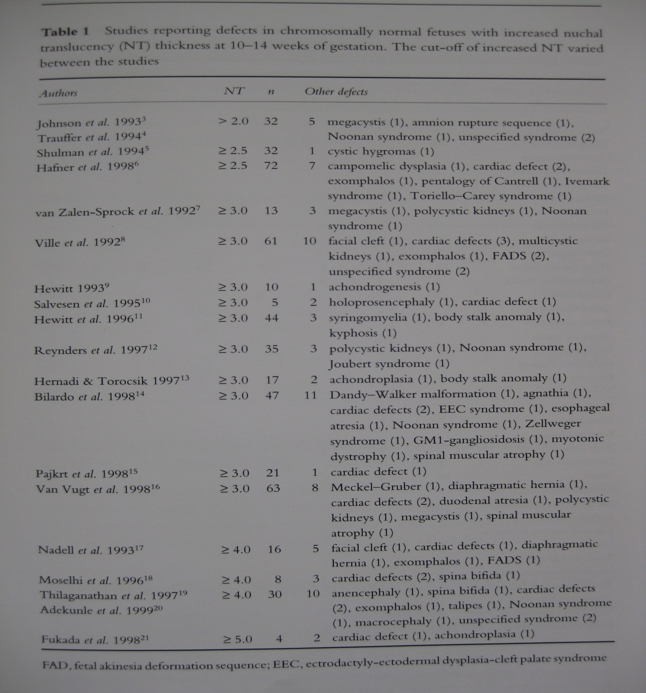

Slide 16
FMF study results
100000 pregnancies…4116 chromosomally normal fetuses with NT>percentile 95th (3.4mm)
Increased NT…increased defects
Increased NT…increased miscarriage and perinatal death
Nl choromosome + NT<4.5 mm: more than 90% normal and no defect
NT<3.5 mm | NT 3.5-4.4 mm | NT 4.5-5.4 mm | NT 5.5-6.4 mm | NT>6.5 mm
2.4% | 7.1% | 12.3% | 16.7% | 35.6%

Slide 17
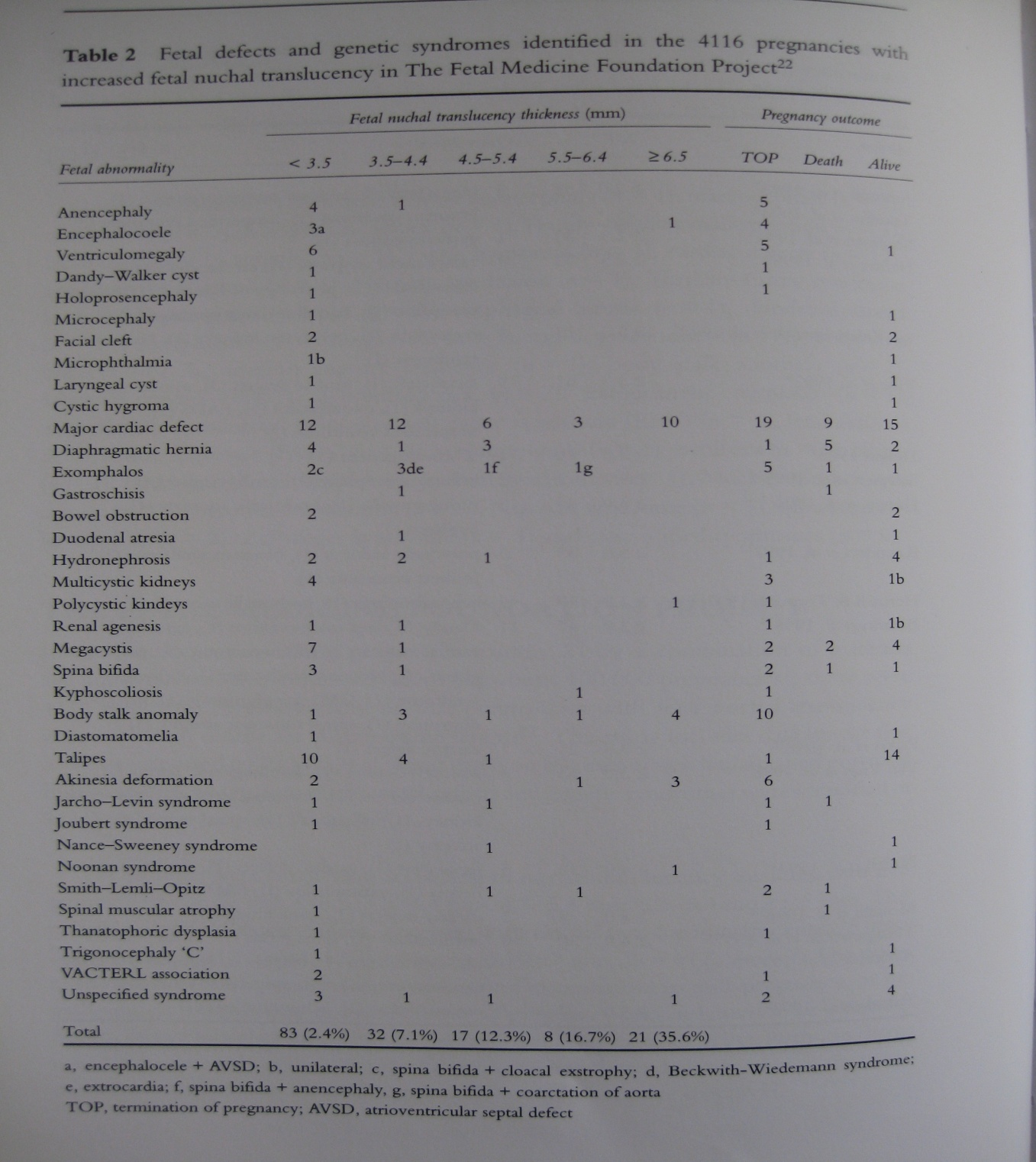

Slide 18
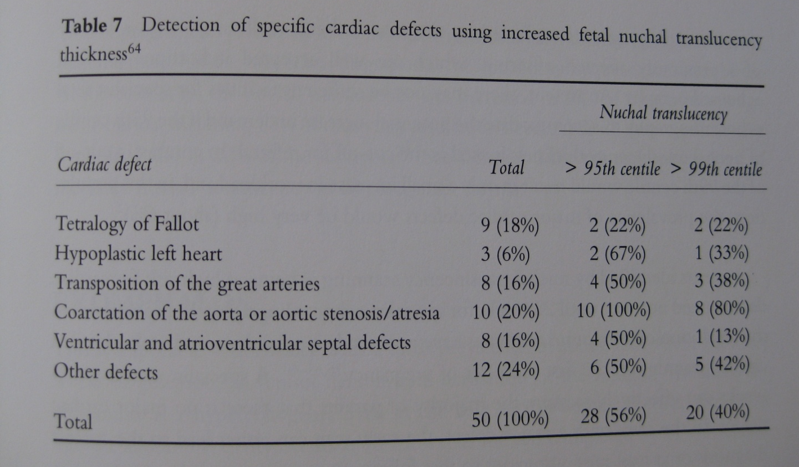
Detection of cardiac defect with NT measurement

Slide 19
NT=>3 mm…
fetus echocardiography (W20-W14)
NT>95th (=>3mm):2% (risk of major cardiac defect)
NT>99th (=>3.5mm) :6% (risk of major cardiac defect)

Slide 20
