Slide 1
FNA /CNB in Ax LN
E.Keshavarz MD
SBMU

Slide 2
Many authors support the indication of axillary US for all breast cancer patients, independently of tumor size. Some of them recommend axillary US only in cases of tumors > 1.0 cm.
US-FNA sensitivity increased in a directly proportional relation with the primary tumor size.
The sensitivity of ultrasound-guided FNA(AJR2014)
29% in primary tumors ≤ 1 cm
50% in tumors > 1 to ≤ 2 cm
69% in tumors > 2 to ≤ 5 cm
100% in patients with tumors > 5 cm
The most important predictive factors for malignancy and US-FNA positiveness are morphological lymph node alterations, independently of primary tumor size.

Slide 3
The sensitivity of ultrasound-guided FNA (AJR2014)
Normal-appearing lymph nodes: 11%
Indeterminate lymph nodes: 44%
Suspicious lymph nodes: 93%
Ultrasound-guided FNA of the axillary lymph nodes is most useful in the preoperative assessment of patients with large tumors (> 2 cm) or lymph nodes that appear abnormal.

Slide 4
Sonographic images demonstrating some lymph nodes classified as morphologically normal, indeterminate and suspicious.

Slide 5
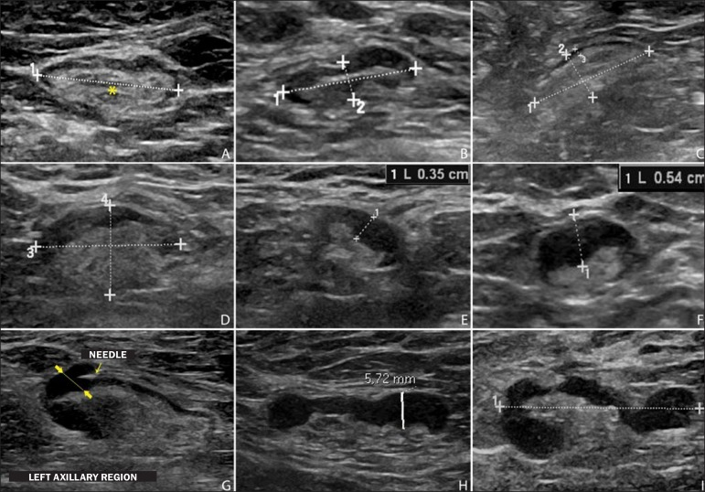
Normal lymph nodes characteristically present with central fatty hilum (asterisk) and diffuse cortical thickening ≤ 3 mm.

Slide 6
The indeterminate lymph nodes presented with central hilum, however with some area with cortical thickening > 3 mm.

Slide 7
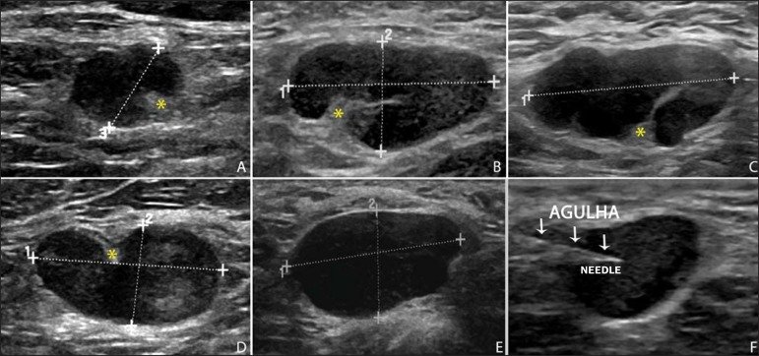
The suspicious lymph node present with marked cortical thickening, determining replacement and marginalization of the fatty hilum .In more advanced cases some lymph nodes may present with total absence of the hilum .

Slide 8
Cortical thickening > 3 mm(2mm?) (especially ≥ 6 mm) and change in the fatty hilum were strongly associated with malignancy.
Other predictive factors of malignancy:
Hypoechogenicity of the cortex
Absence of central flow/peripheral nodal vascularity
short-long axis ratio >0.5
Short axis >10 mm
SIZE:Transverse lymph node diameter ≥ 1 cm was the only factor indicating increased US-FNA sensitivity.

Slide 9
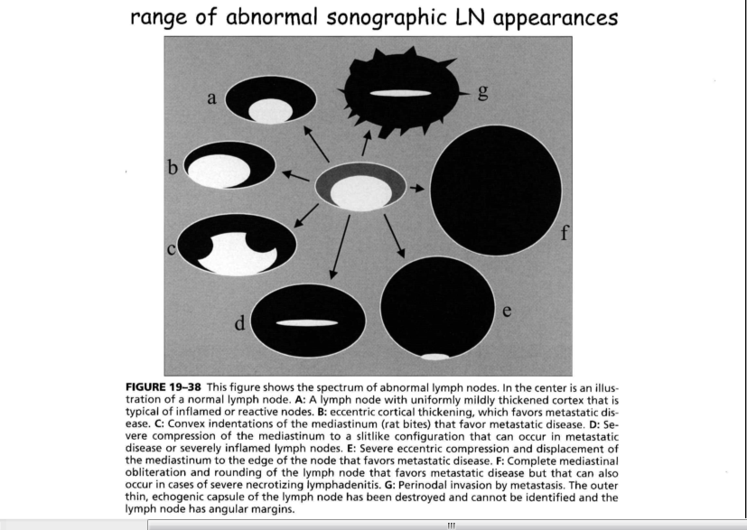

Slide 10
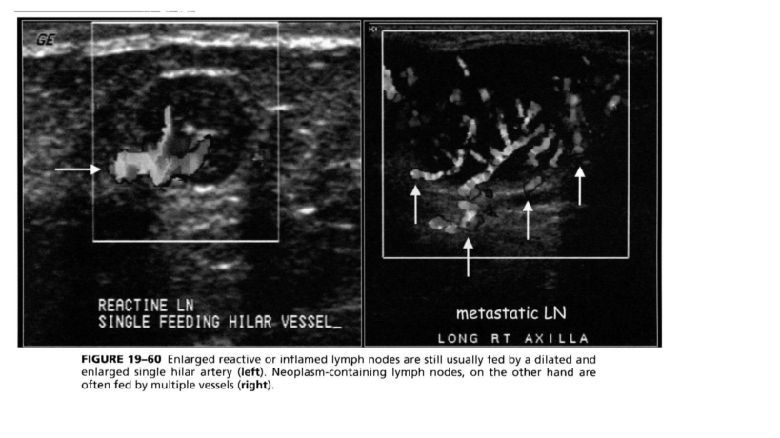

Slide 11
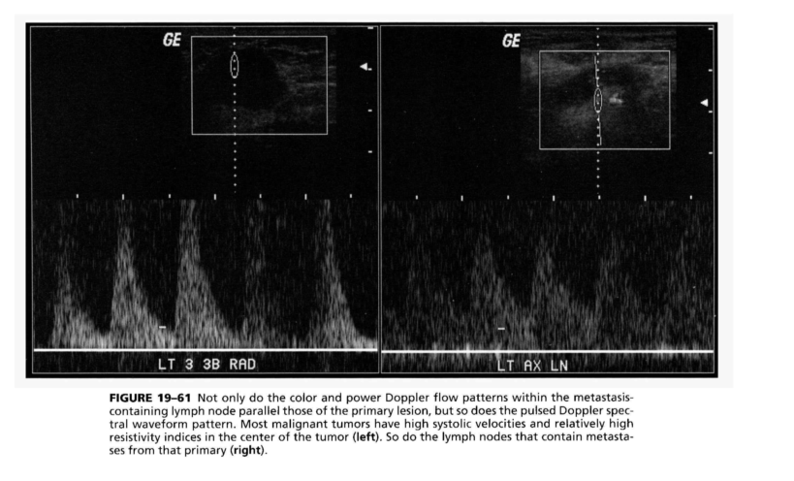

Slide 12
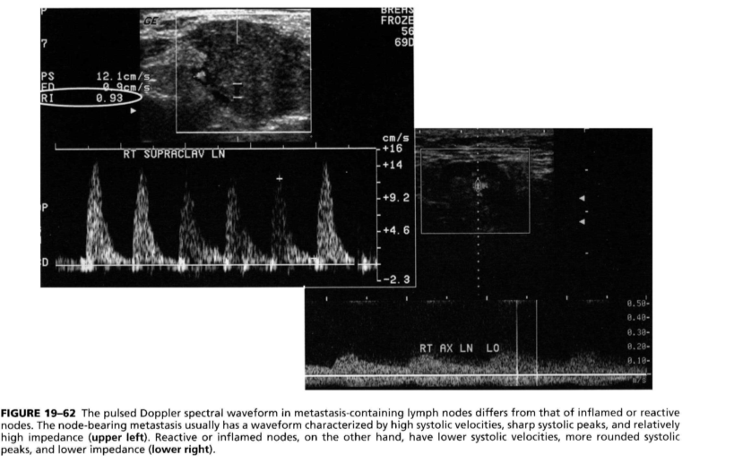

Slide 13
Right to left symmetry or asymmetry
Marked right to left asymmetry in the involvement of axillary lymph nodes favors metastatic disease over inflammation. Viral lymphadenitis can be slightly asymmetric but is rarely truly unilateral. Although unilateral involvement favors neoplasm over inflammation it does not exclude inflammation or infection. unilateral bacterial infection of the arm or breast can cause unilateral reactive lymphadenopathy that can be sonographically indistinguishable from neoplastic involvement.

Slide 14
Infectious processes such as tuberculosis , cat-scratch disease, human immunodeficiency virus, and mononucleosis
Mastitis or upper extremity infection
Connective tissue diseases such as rheumatoid arthritis, systemic lupus erythematosus, psoriatic arthritis, dermatomyositis-polymyositis, and systemic scleroderma are associated with bilateral axillary lymphadenopathy
Granulomatous disease, including Wegener granulomatosis and sarcoidosis, occasionally cause axillary lymphadenopathy on breast images

Slide 15
Carcinoma of Unknown Primary
(CUP syndrome)

Slide 16
Report
Report of the detail leveling: NO
Report the numbers and size in detail: No
Report of pathologic LN(1 to 100): Ax Dissection

Slide 17
TECHNIQUE
Initially the patients were explained about the reason for the procedure, the procedural technique, risks and benefits, existence of alternative techniques, and then they are asked to sign a term of free and informed consent.
Next, asepsis was performed in the axillary region, and anesthesia was applied to the skin (about 3 mL lidocaine at 2%). The puncture was performed with a 21-gauge needle on a 10 mL syringe.

Slide 18
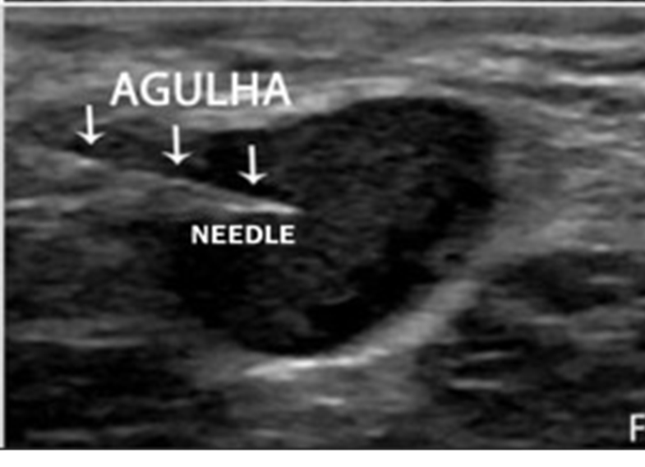
In order to obtain the cytological material, the needle was moved in various directions (fan shaped movements) maintaining vacuum that was undone before removal of the needle.
In the lymph nodes with focal cortical thickening, preferably the aspiration was performed in the altered region .
A sonographic image was acquired showing the tip of the needle within the target.
Enough aspirates were obtained to prepare two slides, which were fixed with 95.6% ethanol, and later sent for cytological analysis.

Slide 19
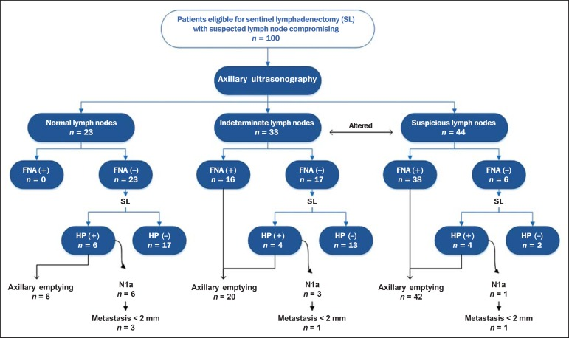
Radiol Bras. 2015 Nov-Dec; 48(6): 345–352.
doi: 10.1590/0100-3984.2014.0121

Slide 20
The sensitivity of US-FNA for lymph nodes considered as normal was 0% (0/6), while for those considered as indeterminate it was 80% (16/20), and for the suspicious ones it was 90.5% (38/42).

Slide 21
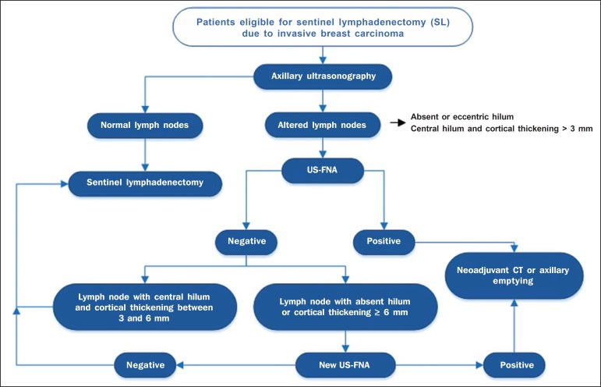
Addition of FNA to US at a single moment can avoid more than 50% of the SLNBs, with a very low incidence of complications and, most probably, a significant reduction in costs and in the time interval until a definitive therapy is implemented.

Slide 22
SLNB: Up to 5% False Negative BUT Recurrence is <1%
Role of positive LN in prognosis??
Z0011: Negative LN imaging up to two LN involvement in SLNB:
NO Ax Dissection
(In post conservative radiation management level 1 is in the field of radiation)

Slide 23
Pre-operative axillary staging: should core biopsy be preferred to fine needle aspiration cytology?(Ecancermedicalscience. 2017; 11: 724.)
FNA
CNB
Sen: 72% (differences in operatorʼs experience)
SPE: 100%
PPV: 100%
NPV: 72%
Sen: 100%
SPE: 100%
PPV: 100%
NPV: 100%

Slide 24
Pre-operative axillary staging: should core biopsy be preferred to fine needle aspiration cytology?(Ecancermedicalscience. 2017; 11: 724.)
Required a second operation :
seven patients (7/43) that had negative cytology at FNA cytology had positive lymph nodes identified at SLNB and therefore required a second surgical procedure /None in CNB
Require a repeat procedure prior to their definitive surgery:
34.8% in FNA (technically inadequate cytology/suspiciouscytology)
2.6% in CNB(repeat CNB because of the discordant result)
The use of US alone has a reported sensitivity of 61.4% as a result we focused on the combined accuracy of US with tissue sampling

Slide 25
Preoperative ultrasound guided percutaneous axillary biopsy in breast cancer patients: fine needle aspiration cytology versus core biopsy.Zosimas D, Lykoudis PM, Vashisht RAnn Ital Chir. 2016; 87():509-516.
Fine-needle aspiration and core biopsy in the diagnosis of breast lesions: A comparison and review of the literature.Mitra S, Dey PCytojournal. 2016; 13():18.
NO statistically significant/NO absolute superiority of CNB over FNA cytology and stated that cytopathologist experience is likely to influence the reported differences in the procedures. Indeed, this suggests that operator skill is likely to play a large role.

