Slide 1
Infants of Diabetic Mothers (IDM)
Dr Naeeme Taslimi Taleghani
Assistant Professor of Pediatrics
(NeonatologisT)
Shahid Beheshti University of Medical Sciences
Mahdie Hospital

Slide 2
Diabetes (type 1, type 2, or gestational) in pregnancy increases the risk of complications and adverse outcomes in the mother and the baby.
Complications related to diabetes are milder in gestational vs pregestational (preexisting type 1 or type 2) diabetes.

Slide 3
Pregnancy outcomes are correlated with onset, duration, and severity of maternal hyperglycemia.
Prepregnancy planning and tight glycemic control (hemoglobin A1c [HbA1c] <6.5%) is crucial in pregestational diabetes in order to achieve the best outcomes for the mother and the baby.

Slide 4
poor control (HbA1c >7%) in the first trimester:
The risk of diabetic embryopathy (neural tube defects, cardiac defects, caudal regression syndrome)
spontaneous abortions
The risk of congenital malformations in gestational diabetes is only slightly increased compared to the general population, since the duration of diabetes is less and hyperglycemia occurs later in gestation (typically >25 wk).

Slide 5
Mothers with pregestational and gestational diabetes have a high incidence of complications during the pregnancy:
Polyhydramnios
preeclampsia
preterm labor (induced and spontaneous)
chronic hypertension
Accelerated fetal growth is also common, and 36–45% of infants of diabetic mothers (IDMs) are born large for gestational age (LGA).
Restricted fetal growth is seen in mothers with pregestational diabetes and vascular disease, but it is less common.

Slide 6
Fetal mortality rate is greater in both pregestational and gestational diabetic mothers than in nondiabetic mothers, but the rates have dropped precipitously over the years.
Fetal loss throughout pregnancy is associated with poorly controlled maternal diabetes, especially diabetic ketoacidosis.

Slide 7
The neonatal mortality rate of IDMs is >5 times that of infants of nondiabetic mothers and is higher at all gestational ages and in every birthweight for gestational age category.
The rate is higher in women with pregestational diabetes:
smoking
obesity
Hypertension
poor prenatal care

Slide 8
PATHOPHYSIOLOGY
maternal hyperglycemia causes fetal hyperglycemia
fetal pancreatic response leads to fetal hyperinsulinemia, or hyperinsulinism.
It is important to recognize that while maternal glucose crosses the placenta, maternal and exogenous insulin dose not.

Slide 9
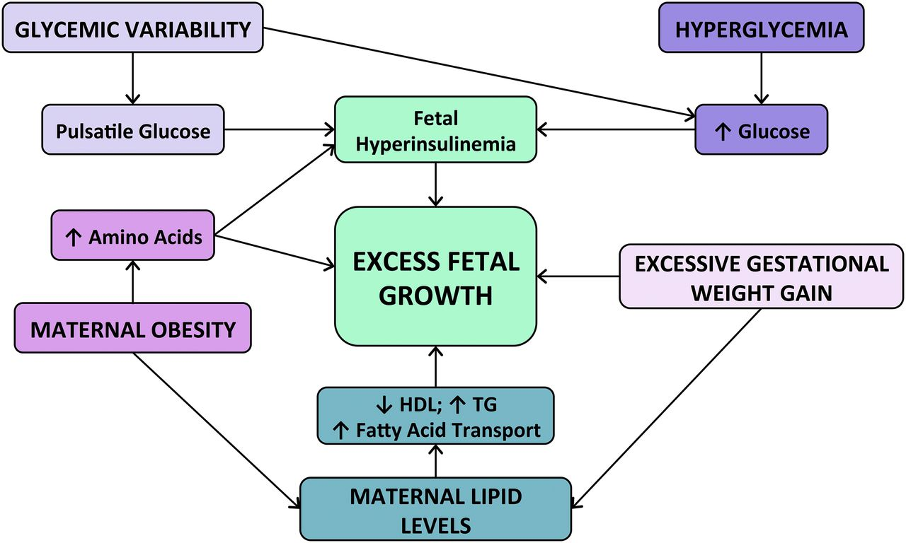
Fetal hyperinsulinemia and hyperglycemia :
increased hepatic glucose uptake
glycogen synthesis
accelerated lipogenesis
augmented protein synthesis

Slide 10
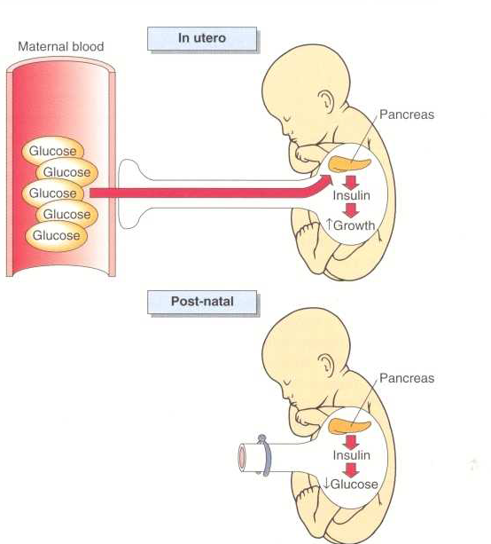
Related pathologic findings are:
hypertrophy and hyperplasia of the pancreatic β cells
increased weight of the placenta and infant organs (except the brain)
myocardial hypertrophy
increased amount of cytoplasm in liver cells
extramedullary hematopoiesis

Slide 11
Hyperinsulinism and hyperglycemia produce:
fetal acidosis( which may result in an increased rate of stillbirth.)
Separation of the placenta at birth suddenly interrupts glucose infusion into the neonate without a proportional effect on hyperinsulinism, leading to hypoglycemia during the 1st few hr after birth.
The risk of rebound hypoglycemia can be diminished by tight blood glucose control during labor and delivery.

Slide 14
pregestational diabetes
The infants of mothers with pregestational diabetes have :
significantly higher fasting plasma insulin levels than normal newborns
( despite similar glucose levels)
Respond to glucose with an abnormally prompt elevation in plasma insulin.
After arginine administration, they also have an enhanced insulin response and increased disappearance rates of glucose compared with normal infants.

Slide 15
gestational diabetes
In contrast, fasting glucose production and utilization rates are diminished in infants of mothers with gestational diabetes.

Slide 16
cause of hypoglycemia:
hyperinsulinism is probably the main cause
diminished epinephrine
diminished glucagon responses.

Slide 18
CLINICAL MANIFESTATIONS
They tend to be large and plump as a result of increased body fat and enlarged viscera
with puffy, plethoric facies resembling that of patients who have been receiving corticosteroids.
These infants may also be of normal birthweight if diabetes is well controlled
low birthweight if they are delivered before term or if their mothers have associated diabetic vascular disease

Slide 19
Infants that are macrosomic or LGA are at high risk of:
birth trauma (brachial plexus injury)
birth asphyxia
because of not only their large size but also their decreased ability to tolerate stress, especially if they have cardiomyopathy and other effects of fetal hyperinsulinemia

Slide 20
Hypoglycemia develops in :
25–50% of infants of mothers with pregestational diabetes
15–25% of infants of mothers with gestational diabetes
only a small percentage of these infants become symptomatic.

Slide 21
The probability that hypoglycemia will develop in such infants increases with:
higher cord or maternal fasting blood glucose levels.

Slide 22
The nadir in an infant’s blood glucose concentration is usually reached between 1 and 3 hr of age.
Hypoglycemia can persist for 72 hr and in rare cases last up to 7 days.
Frequent feedings can be used to treat the hypoglycemia, but some infants require intravenous (IV) dextrose

Slide 23
The infants tend to be jittery, tremulous, and hyperexcitable during the 1st 3 days after birth
Hypotonia
Lethargy
Poor sucking may also occur
More likely to be related to hypoglycemia but can also be caused by hypocalcemia and hypomagnesemia, which also occur in the 1st 24-72 hr of life due to delayed response of the parathormone system.
Perinatal asphyxia is associated with increased irritability and also increases the risk of hypoglycemia, hypomagnesemia, and hypocalcemia.

Slide 24
Tachypnea develops in many IDMs during the 1st 2 days after birth and may be a manifestation of:
hypoglycemia
Hypothermia
Polycythemia
cardiac failure
transient tachypnea
cerebral edema from birth trauma or asphyxia

Slide 25
IDMs have a higher incidence of respiratory distress syndrome (RDS) than do infants of nondiabetic mothers born at comparable gestational age.
An antagonistic effect of insulin on stimulation of surfactant synthesis by cortisol
leading to a delay in lung maturation
Polycythemia often occurs with RDS as they are both a result of fetal hyperinsulinism.

Slide 26
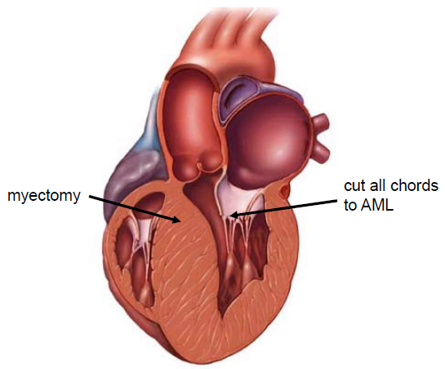
Cardiomegaly is common (30%), and heart failure occurs in 5-10% of IDMs. Interventricular septal hypertrophy may occur and may manifest as transient idiopathic hypertrophic subaortic stenosis.
ultimately the condition resolves spontaneously over time.
This is thought to result from chronic hyperglycemia and chronic hyperinsulinism leading to glycogen loading in the heart. Inotropic agents worsen the obstruction and are contraindicated. β-Adrenergic blockers have been

Slide 27
Acute neurologic abnormalities (lethargy, irritability, poor feeding) can be seen immediately after birth and the cause elucidated by the timing of symptoms, as previously discussed (hypoglycemia, hypocalcemia, hypomagnesemia, or birth asphyxia).

Slide 28
Neurologic development and ossification centers tend to be immature and to correlate with brain size (which is not increased) and gestational age rather than total body weight in infants of mothers with gestational and pregestational diabetes.

Slide 29
In addition, IDMs have an increased incidence of :
Hyperbilirubinemia
Polycythemia
Iron deficiency
Renal vein thrombosis.
Renal vein thrombosis should be suspected in the infant with a flank mass, hematuria, and thrombocytopenia.

Slide 30
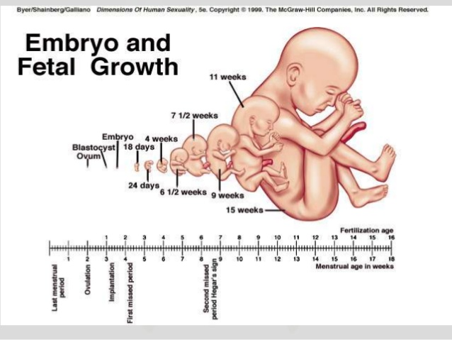
There is a 4-fold increase in congenital anomalies in infants of mothers with pregestational diabetes, and the risk varies with HbA1c during the first trimester when organogenesis occurs.

Slide 31
The recommended goal for periconceptual HbA1c is <6.5%.
Congenital anomalies of the central nervous system and cardiovascular system are most common
including:
Failure of neural tube closure (encephalocele, meningomyelocele, and anencephaly)
Transposition of great vessels
Ventricular septal defect (VSD)
Atrial septal defect (ASD)
Hypoplastic left heart
Aortic stenosis
Coarctation of the aorta.

Slide 32
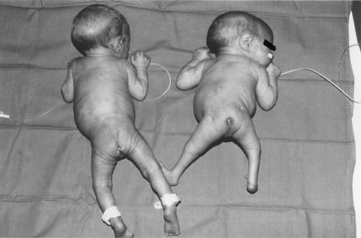
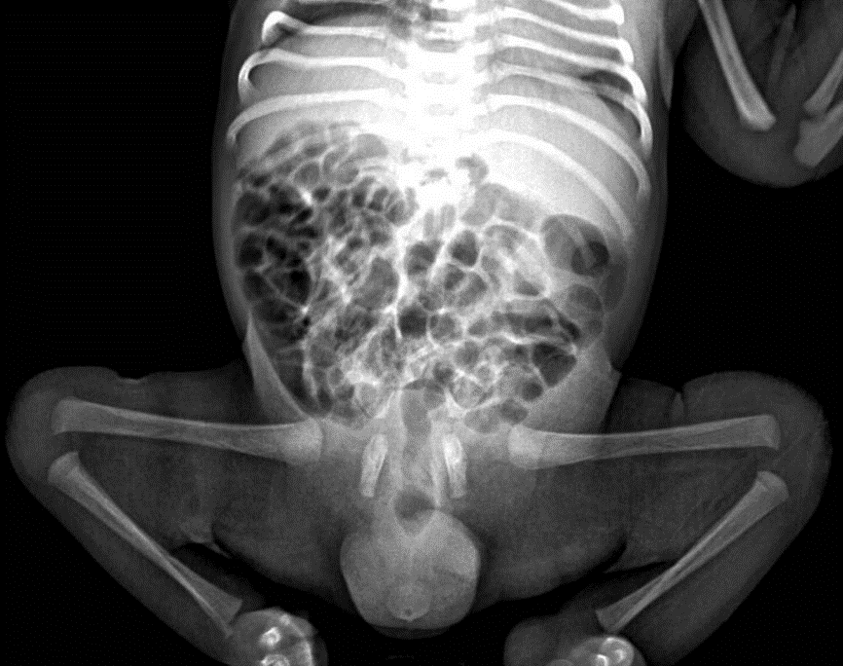
less common anomalies include:
caudal regression syndrome
intestinal atresia
renal agenesis
hydronephrosis
cystic kidneys.
Small left colon syndrome

Slide 33
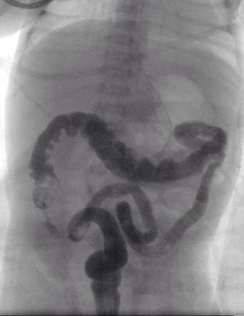
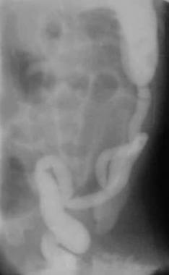
Small left colon syndrome is a rare anomaly that develops in the second and third trimester because of rapid fluctuations in maternal and therefore fetal glucose, leading to impaired intestinal motility and subsequent intestinal growth.

Slide 34
TREATMENT
Preventive treatment of IDMs should be initiated before birth by means of preconception and frequent prenatal evaluations of all women with preexisting diabetes and pregnant women with gestational diabetes.

Slide 35
Women with type 1 diabetes who have tight glucose control during pregnancy (average daily glucose levels <95 mg/dL) deliver infants with birthweight and anthropomorphic features similar to those of infants of nondiabetic mothers.

Slide 36
Treatment of gestational diabetes (diet, glucose monitoring, metformin, and insulin therapy as needed) decreases the rate of serious perinatal outcomes (death, shoulder dystocia, bone fracture, or nerve palsy).

Slide 37
Women with gestational diabetes may also be treated successfully with glyburide, which may not cross the placenta.
In these mothers, the incidence of macrosomia and neonatal hypoglycemia is similar to that in mothers with insulin-treated gestational diabetes.
Women with diabetes can begin to express breast milk before the birth of the baby
(≥36 wk gestational age); this will provide an immediate supply of milk to prevent hypoglycemia.

Slide 38
Regardless of size, IDMs should initially receive close observation and care .
Infants should initiate feedings within 1 hr after birth.
A screening glucose test should be performed within 30 min of the first feed
The target plasma glucose concentration is ≥40 mg/dL before feeds in the 1st 48 hr of life.

Slide 39
Transient hypoglycemia is common during the 1st 1-3 hr after birth and may be part of normal adaptation to extrauterine life.
Treatment is indicated if the plasma glucose is <47 mg/dL.
Feeding is the initial treatment for asymptomatic hypoglycemia
Oral or gavage feeding with breast milk or formula can be given.
An alternative is prophylactic use of dextrose gel, although early feedings may be equally effective.

Slide 40
Recurrent hypoglycemia can be treated with repeat feedings or IV glucose as needed.

Slide 41
Infants with persistent (and unresponsive to oral therapy) glucose levels
<25 mg/dL during the 1st 4 hr after birth
<35 mg/dL at 4-24 hr after birth
Should be treated with IV glucose, especially if symptomatic.

Slide 42
A small bolus of 200 mg/kg of dextrose (2 mL/kg of 10% dextrose) should be administered to infants with plasma glucose below these limits.
The small bolus should be followed by a continuous IV glucose infusion to avoid hypoglycemia.

Slide 43
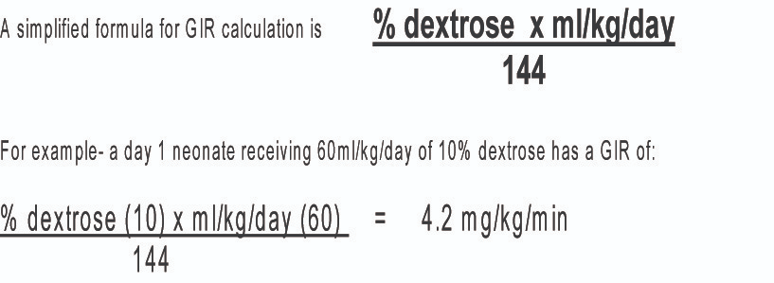
If question arises about an infant’s ability to tolerate oral feeding, a continuous peripheral IV infusion at a rate of 4-8 mg/kg/min should be given.

Slide 44
Neurologic symptoms of hypoglycemia must be treated with IV glucose.
Bolus injections of hypertonic (25%) glucose should be avoided because they may cause further hyperinsulinemia and potentially produce rebound hypoglycemia.

Slide 45
Screening
Screening algorithm for asymptomatic hypoglycemia during first day of life among at-risk infants.
Screening is indicated for:
late preterm infants
Small for gestational age
Intrauterine growth restriction
Infants of obese
Infants of diabetic mothers.

Slide 46
1)Continue monitoring blood glucose concentrations until 3 consecutive blood glucose concentrations have been ≥45-50 mg/dL.
2)There is no consensus for a threshold definition for neonatal hypoglycemia in the first day of life.
Nonetheless, if the blood glucose is less than 45-50 mg/dL AND symptoms compatible with hypoglycemia are present treatment must be initiated with an IV minibolus of 10% glucose at 200 mg/kg followed by a continuous IV infusion of glucose at a starting rate of 5-8 mg/kg/min.

Slide 49
Express breast milk=EBM

Slide 50
PROGNOSIS
The subsequent incidence of diabetes mellitus in IDMs is higher than that in the general population because of genetic susceptibility in all types of diabetes.
Infants of mothers with either pregestational diabetes or gestational diabetes are at risk for obesity and impaired glucose metabolism in later life as a result of intrauterine exposure to hyperglycemia.

Slide 51
Disagreement persists about whether IDMs have a slightly increased risk of impaired intellectual development because of the many confounding factors (e.g., parental education, maternal age, neonatal complications).
In general, the outcomes have improved over the last several decades due to increased awareness, screening, and improved prenatal care for pregnant women with diabetes

Slide 52
Dr Naeeme Taslimi Taleghani
Assistant Professor of Pediatrics
(Neonatologist)
Shahid Beheshti University of Medical Sciences
Mahdie Hospital

